Slide 1
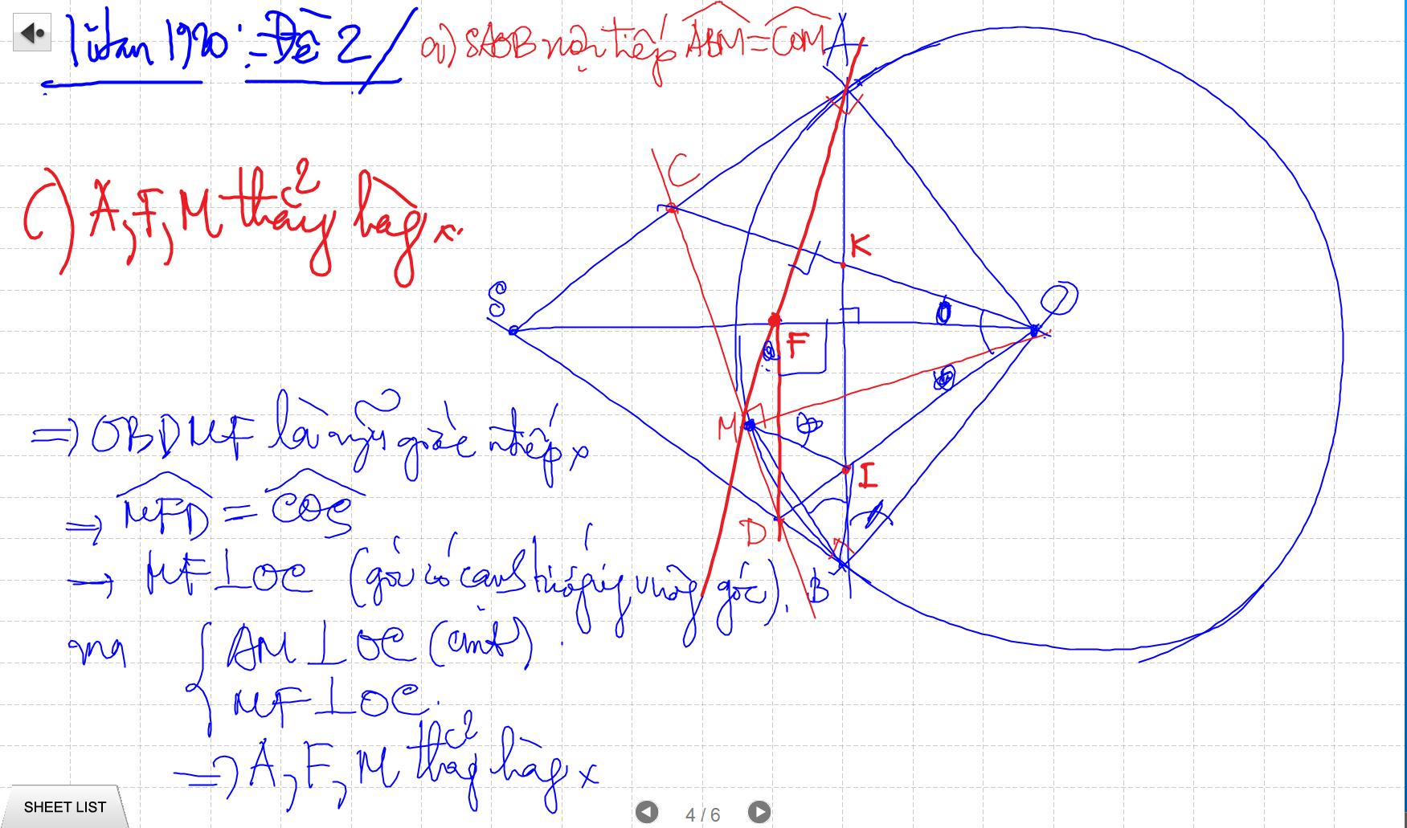

Slide 2
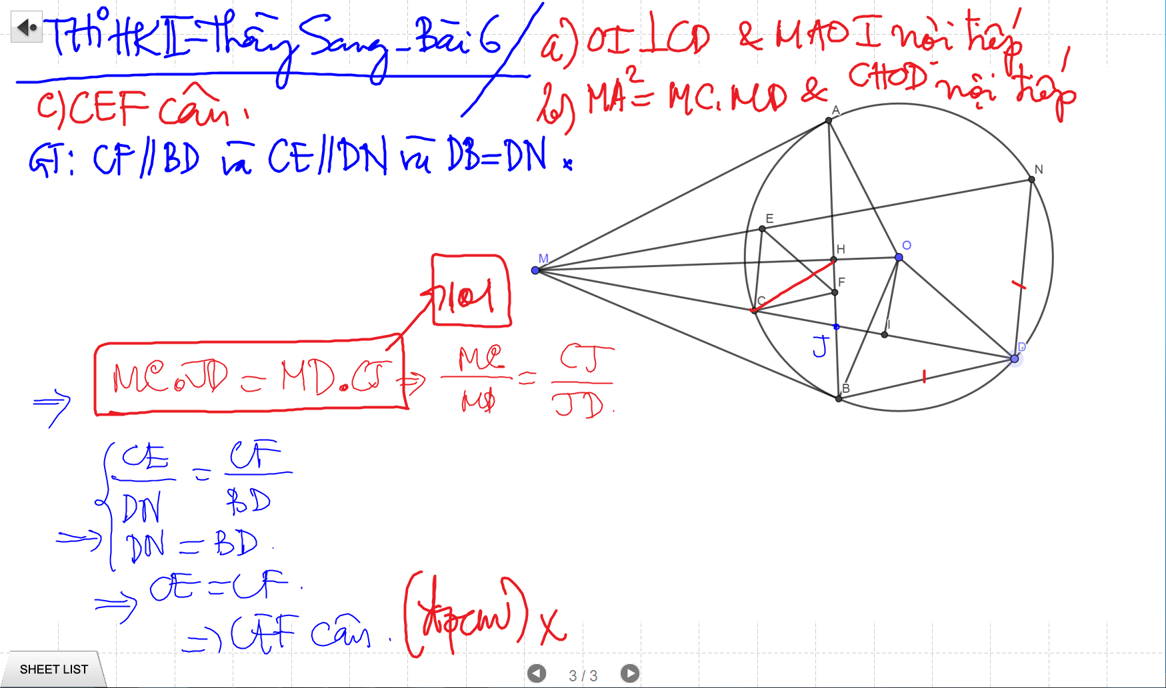

Slide 3
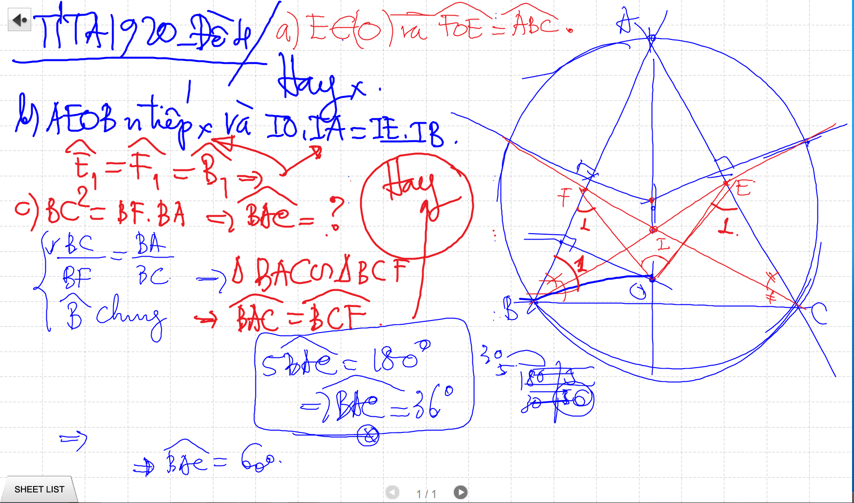

Slide 4
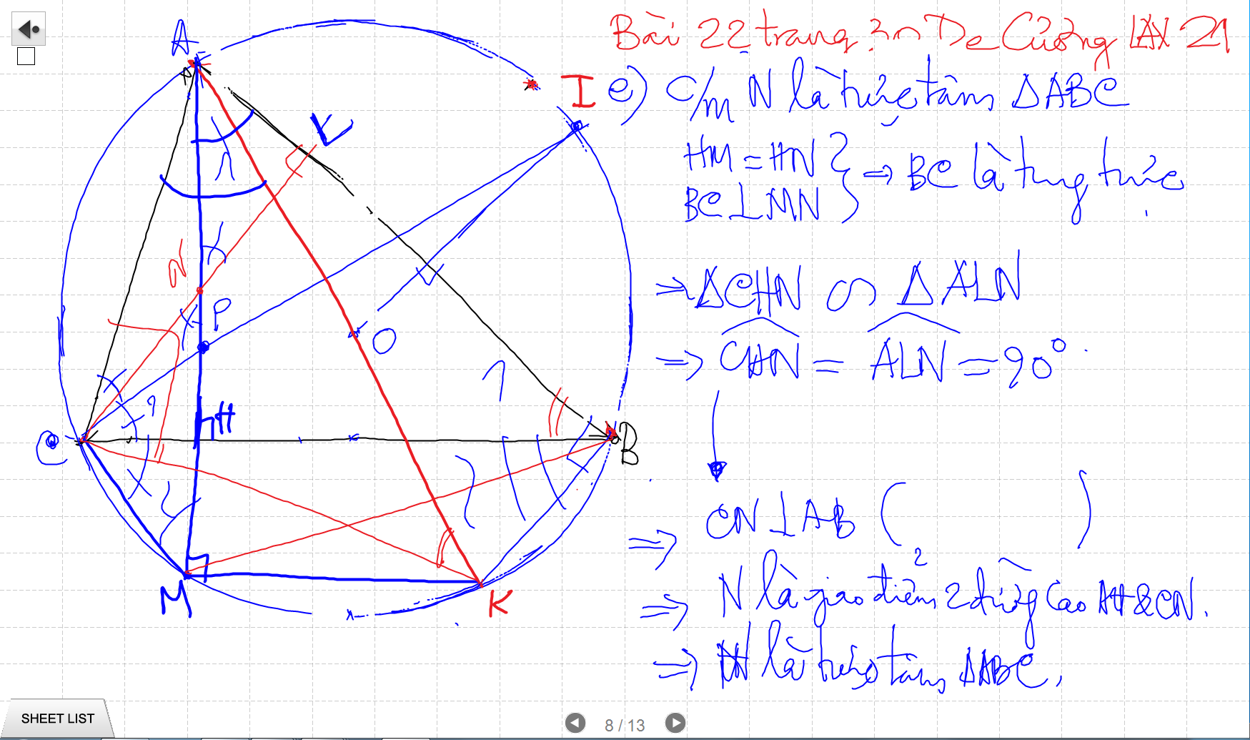

Slide 5
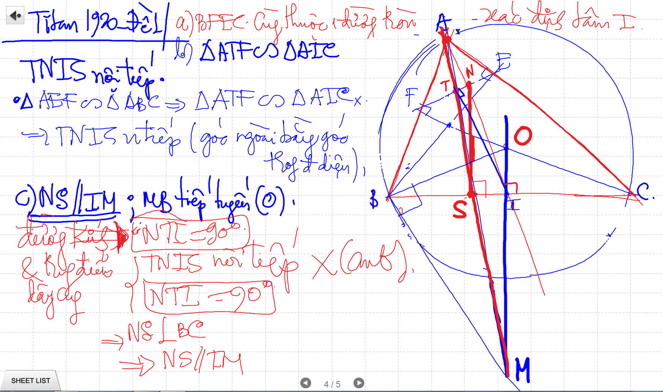

Slide 6
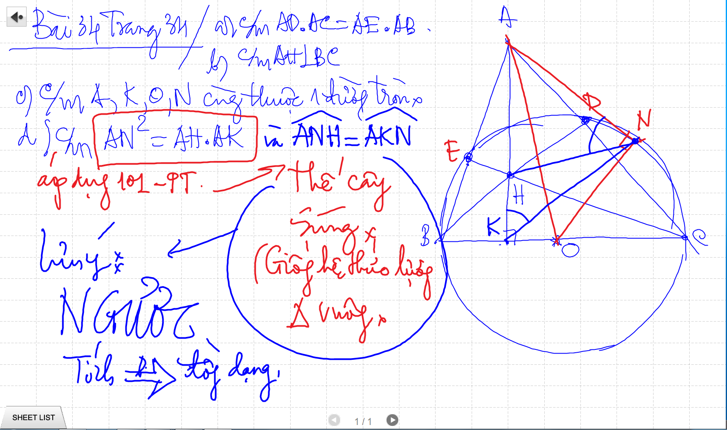

Slide 7
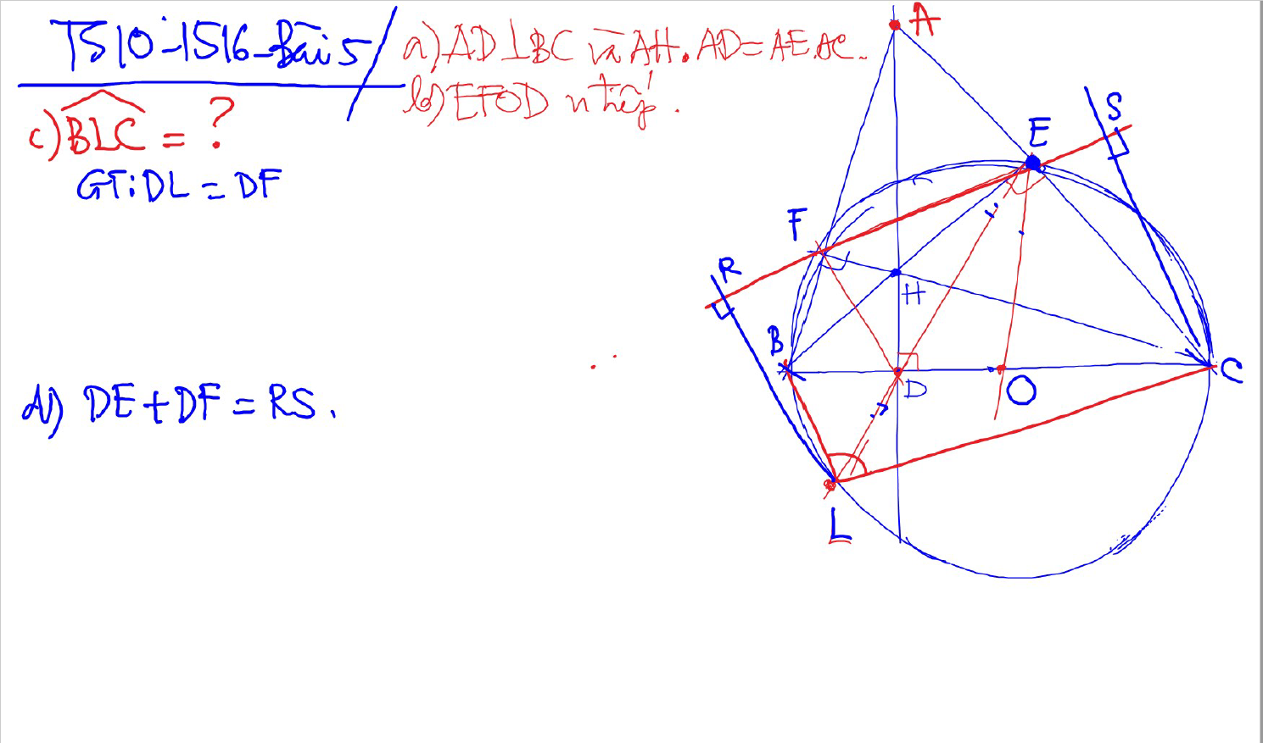
C/m tam giac dong dang truong hop 2

Slide 8
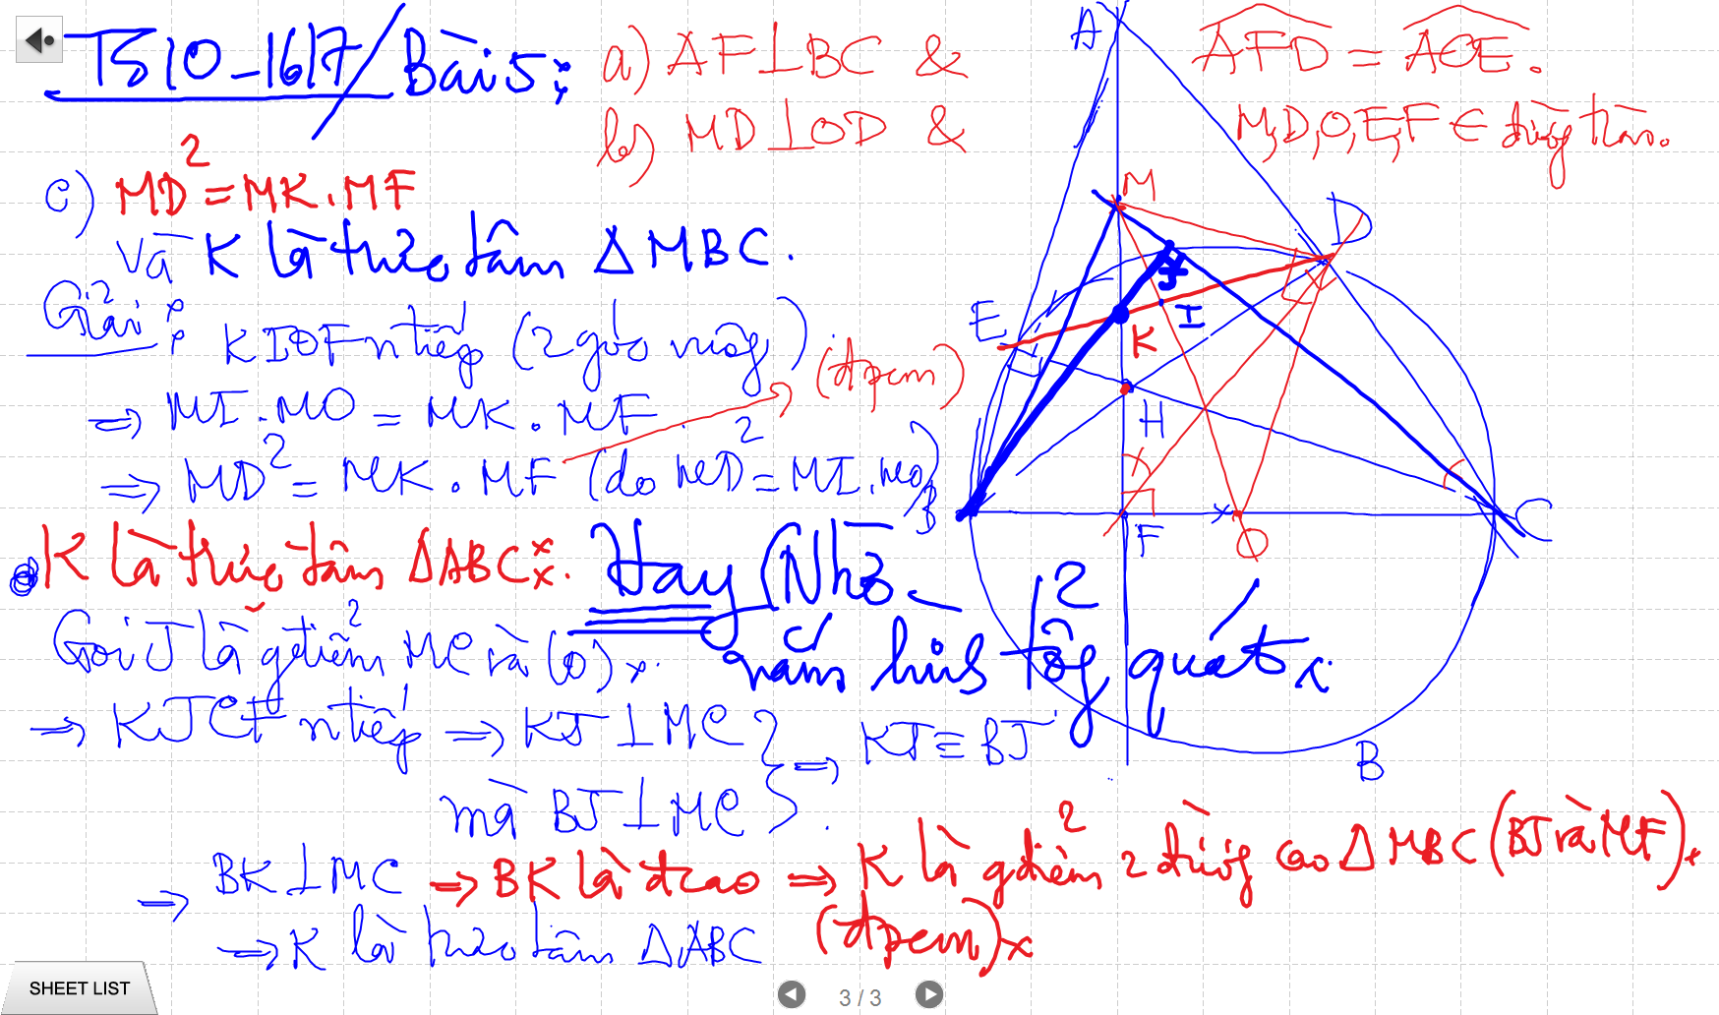
C/m tam giac dong dang truong hop 2

Slide 9
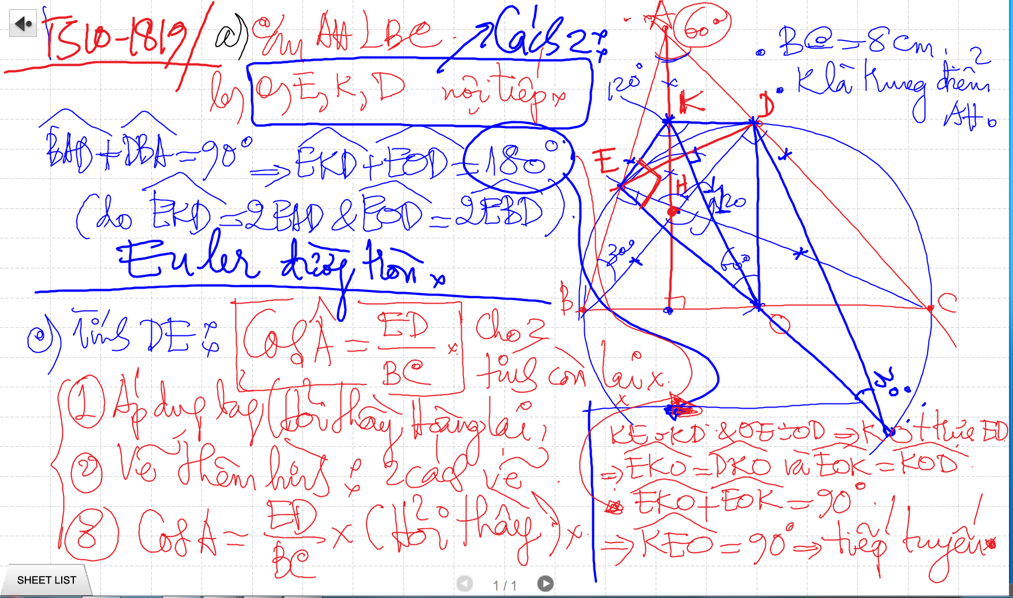
Bai 53 De Cuong – Euler

Slide 10
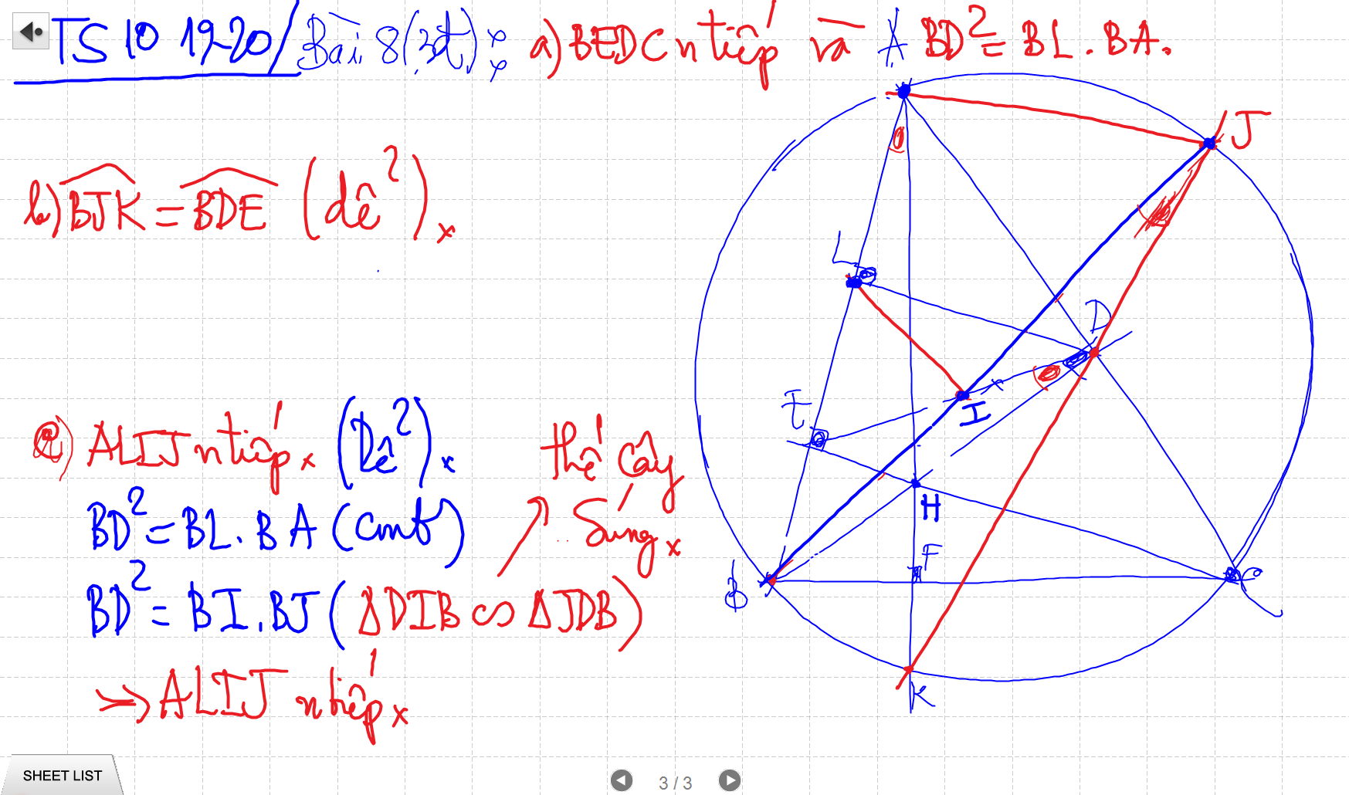
Bai 53 De Cuong – Euler

Slide 11
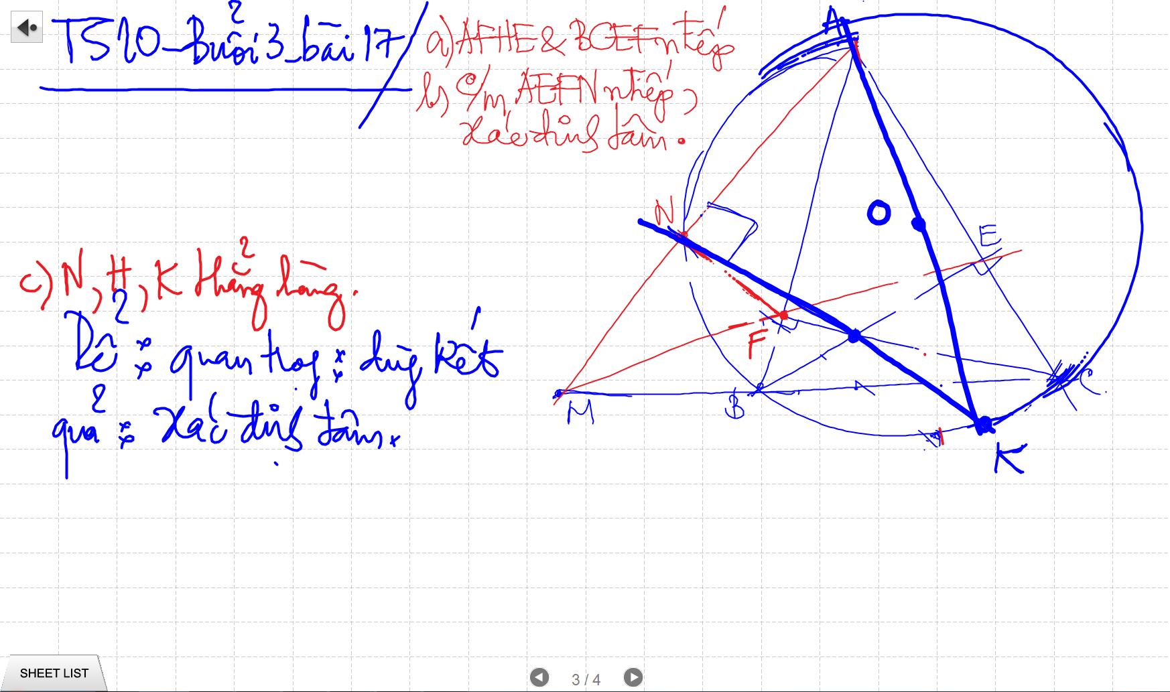
C/m tam giac dong dang truong hop 2

Slide 12
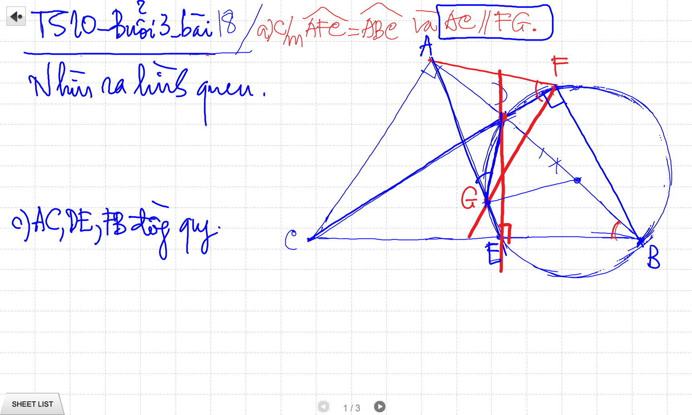
C/m tam giac dong dang truong hop 2

Slide 13
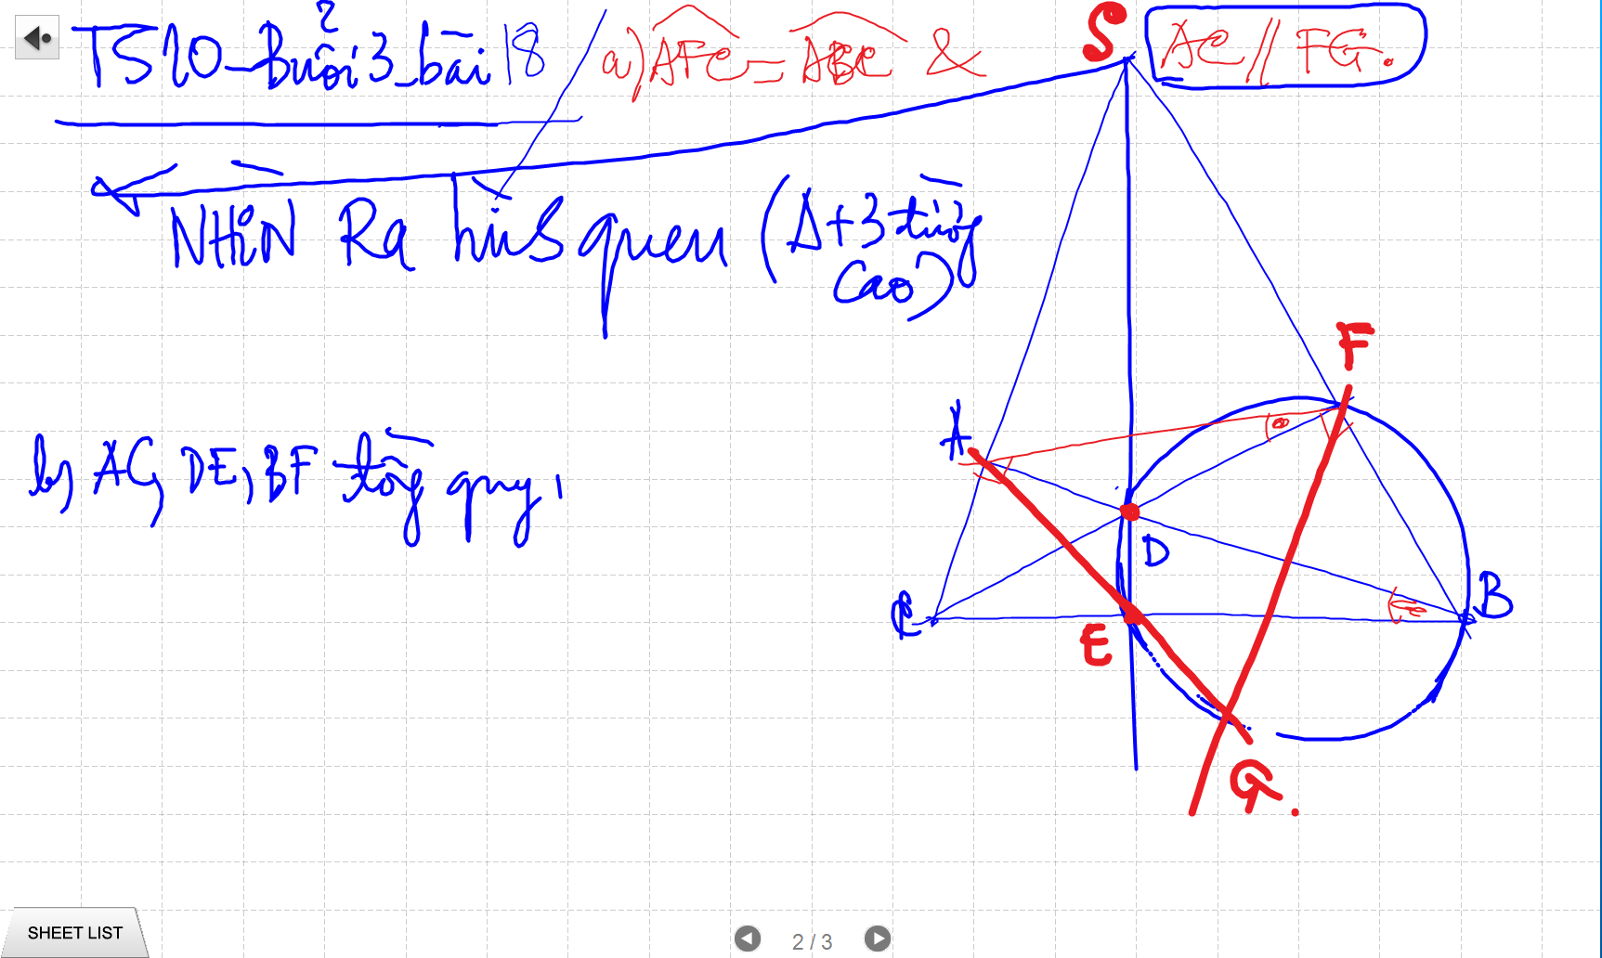
C/m tam giac dong dang truong hop 2

Slide 14
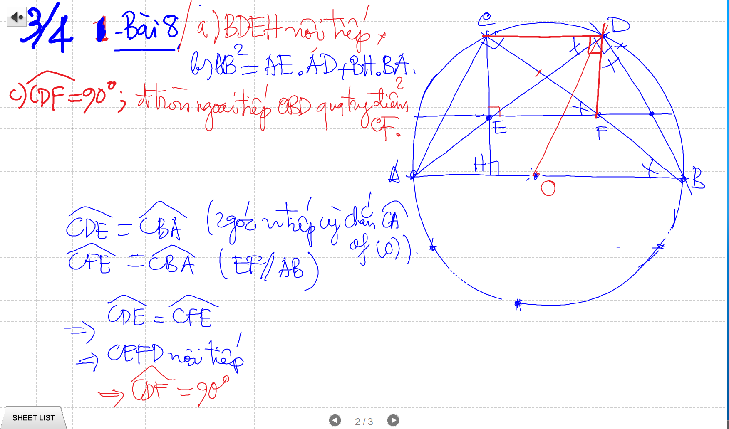
C/m tam giac dong dang truong hop 2

Slide 15
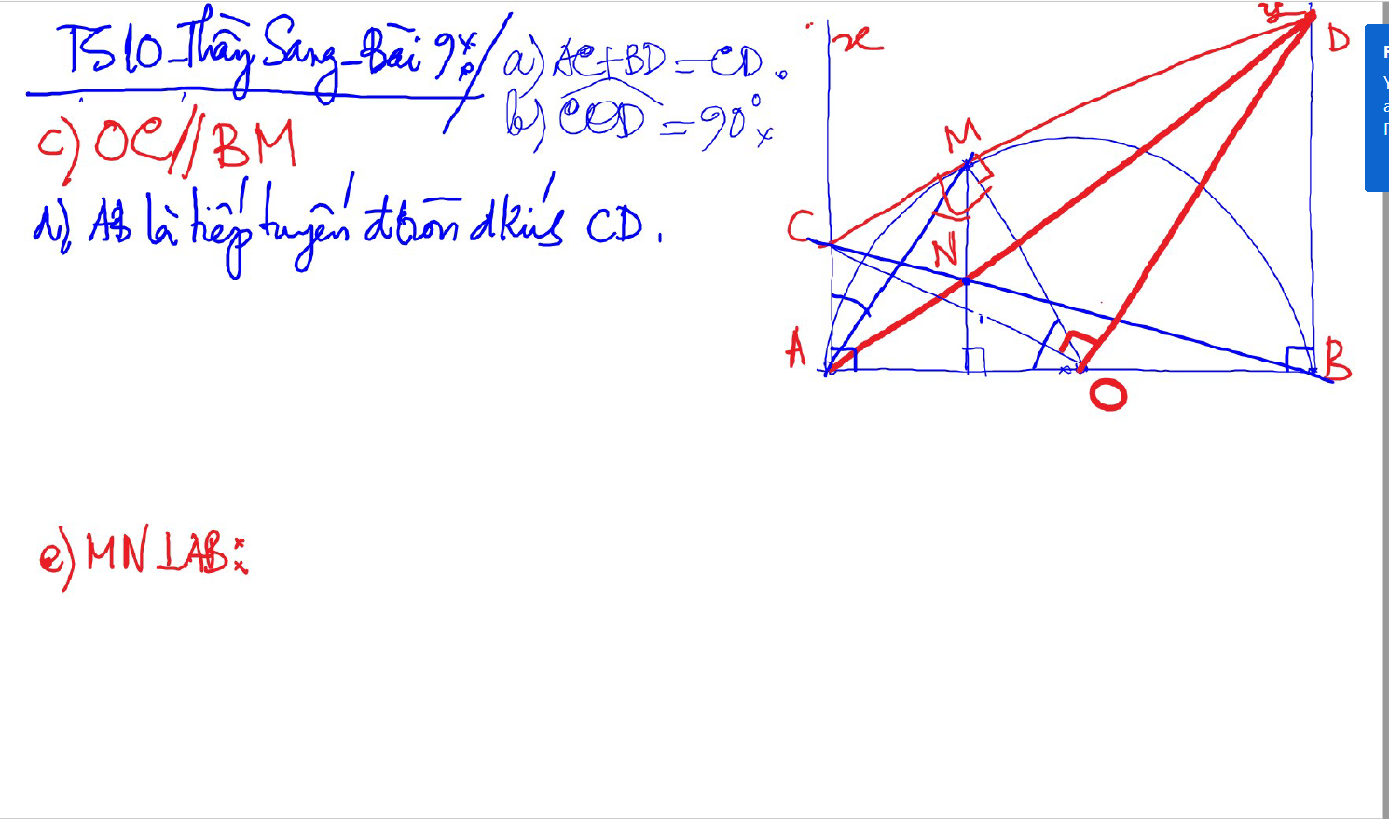

Slide 16
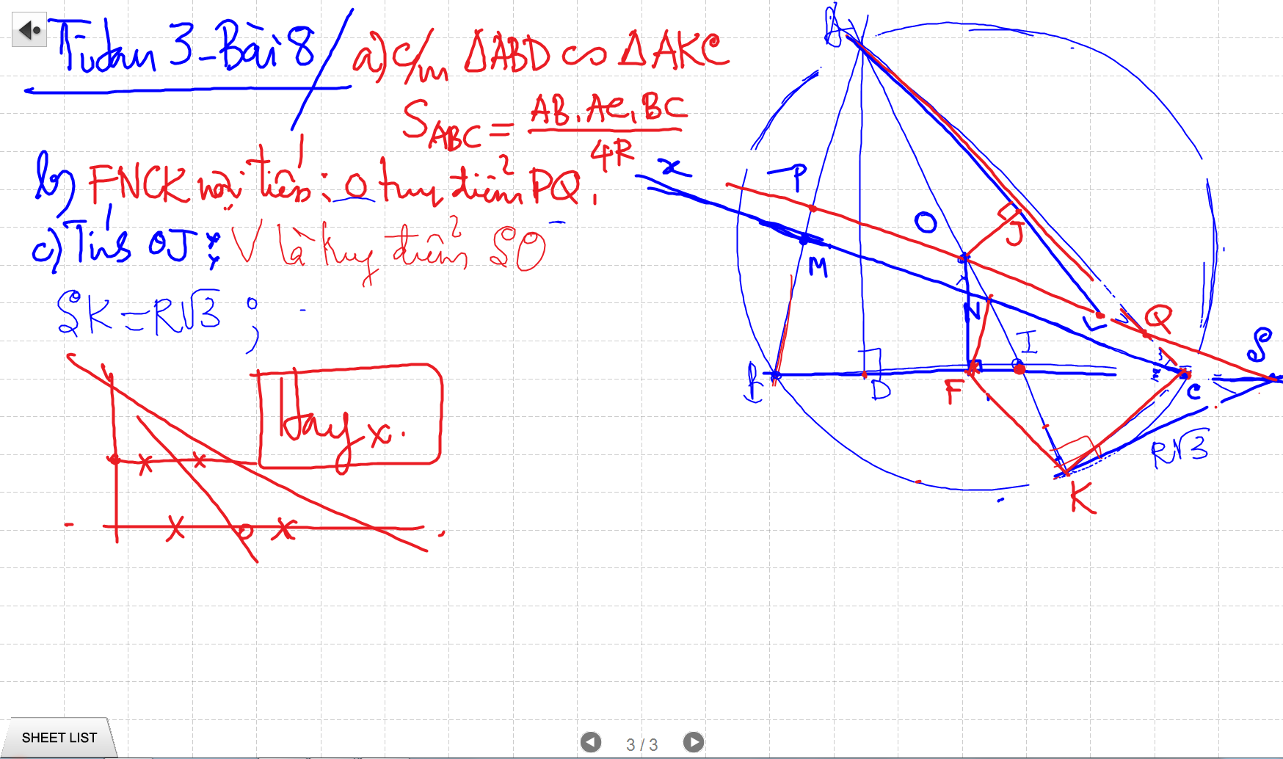
C/m tam giac dong dang truong hop 2

Slide 17
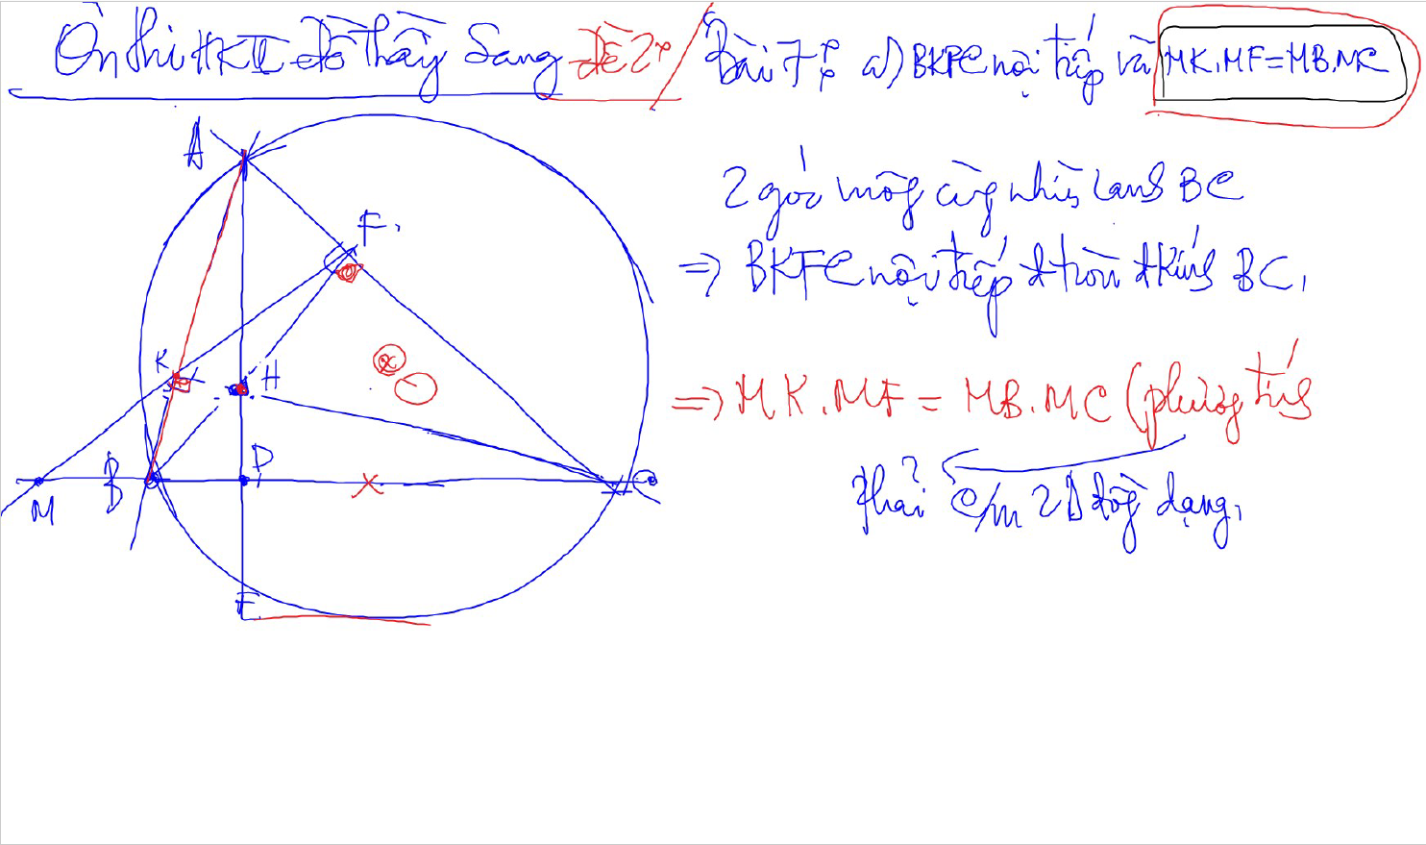
C/m tam giac dong dang truong hop 2

Slide 18
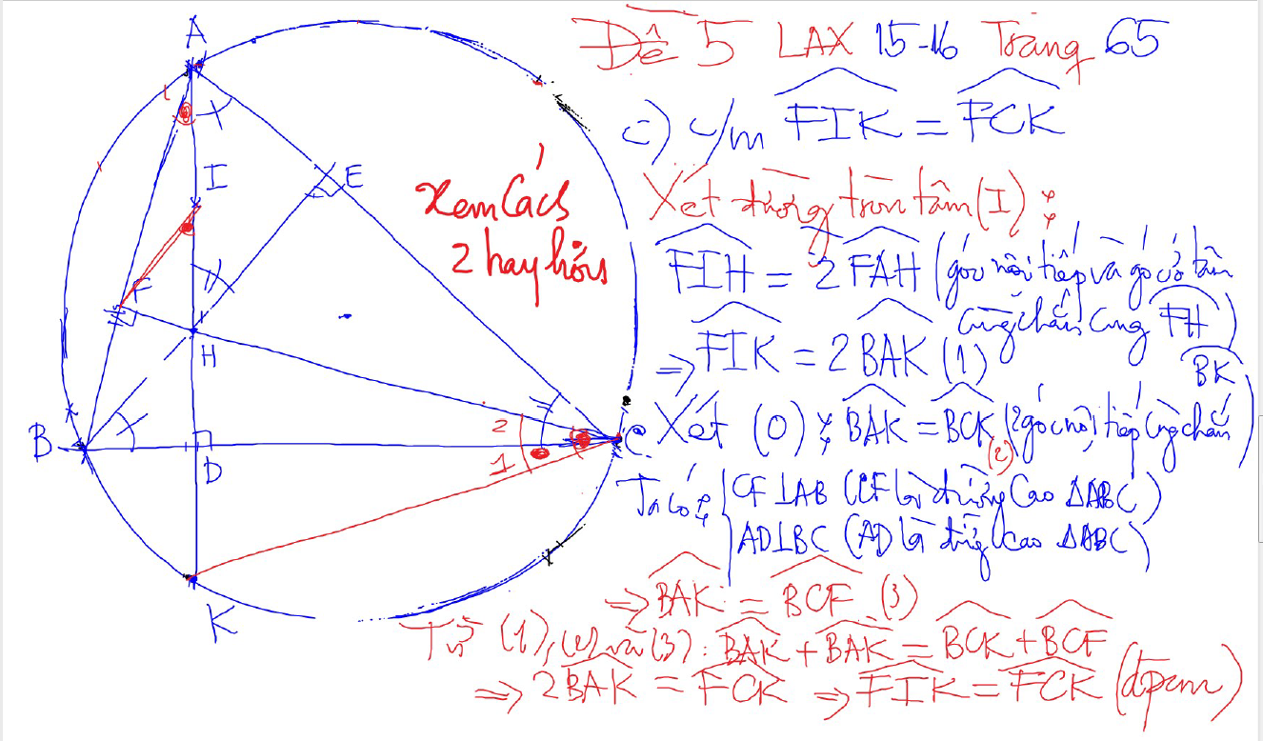
DUONG THANG SIMSON – Ap Dung

Slide 19
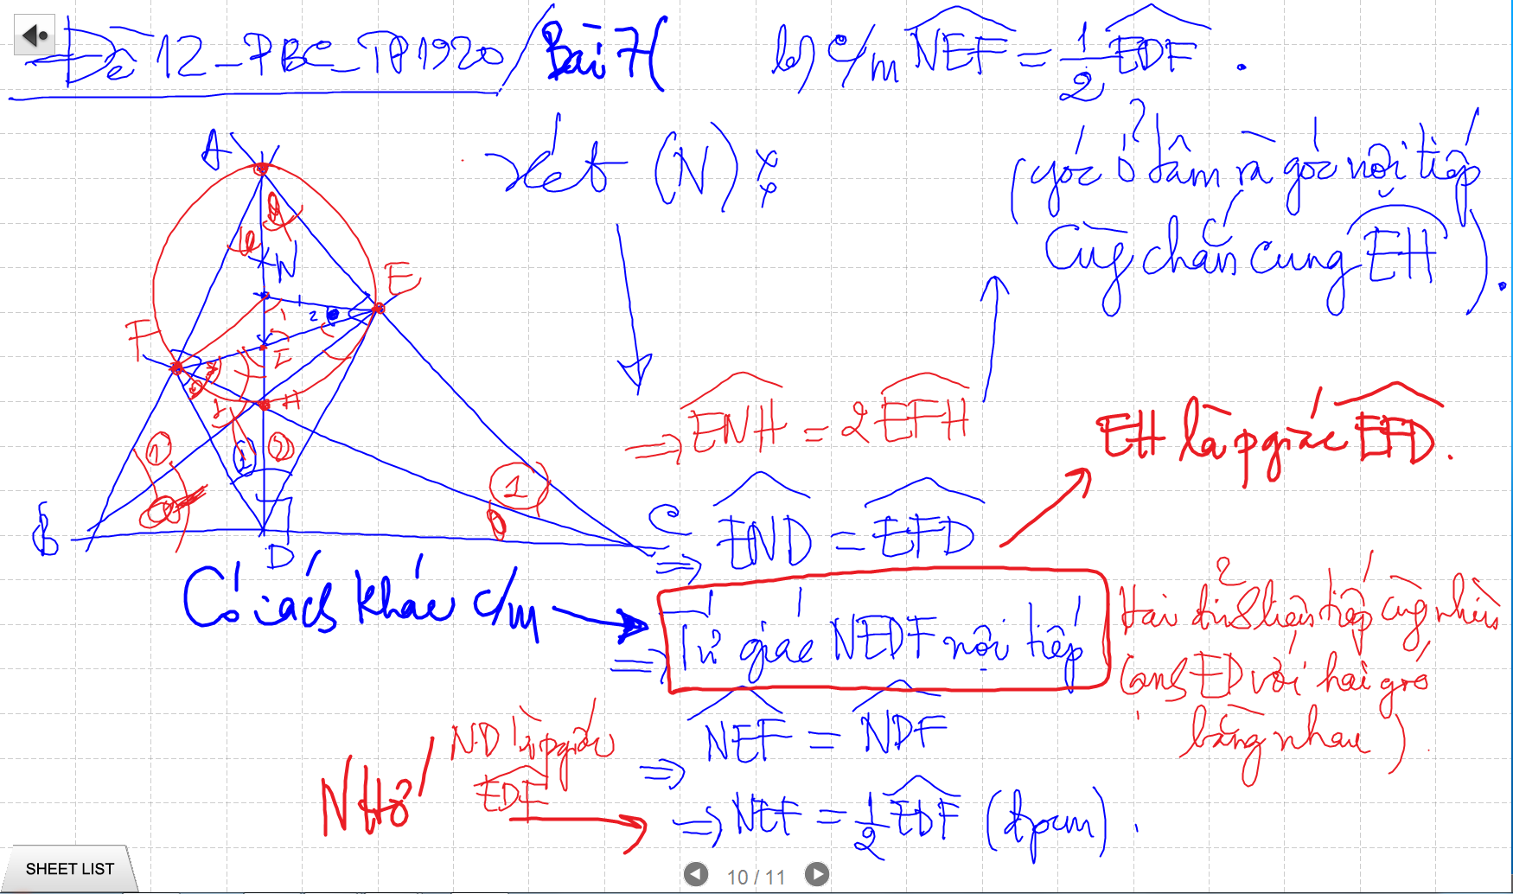
CM TU GIAC NOI TIEP -> SUY RA CAC GOC BANG NHAU

Slide 20
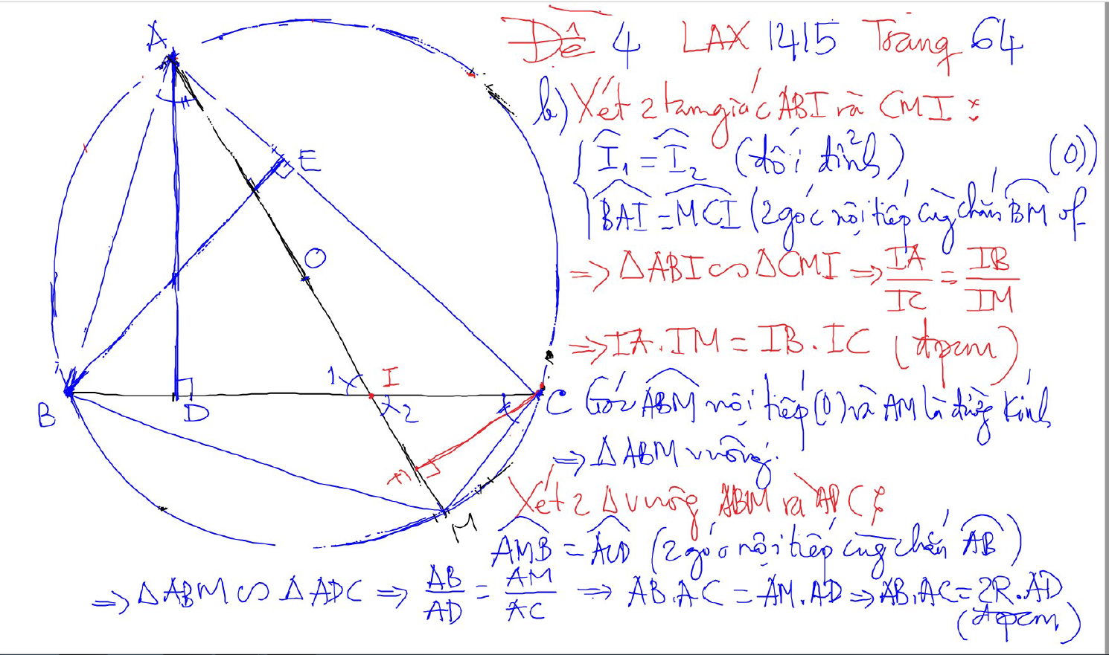
PHUONG TICH DIEM TRONG DUONG TRON

Slide 21
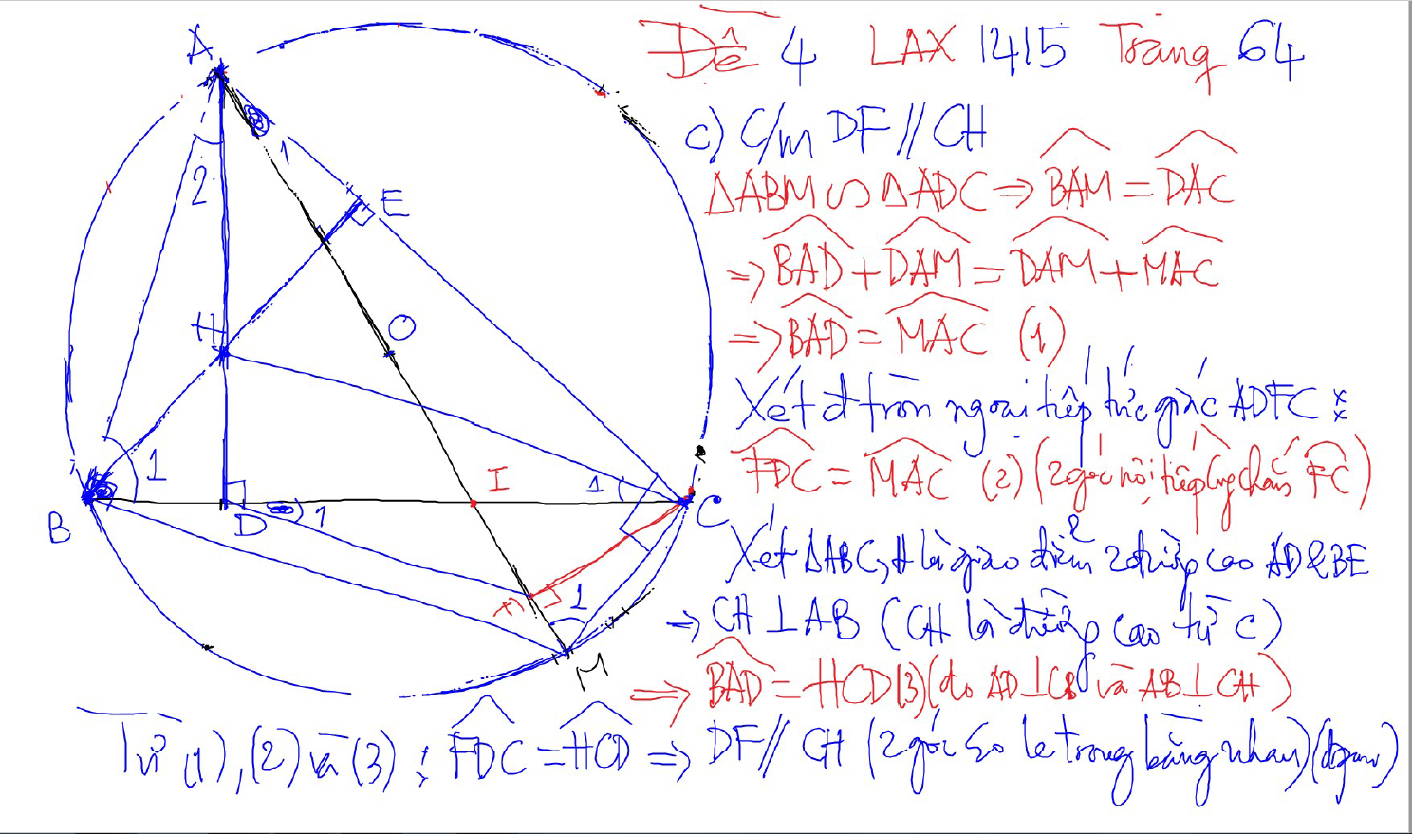
PHUONG TICH DIEM TRONG DUONG TRON

Slide 22
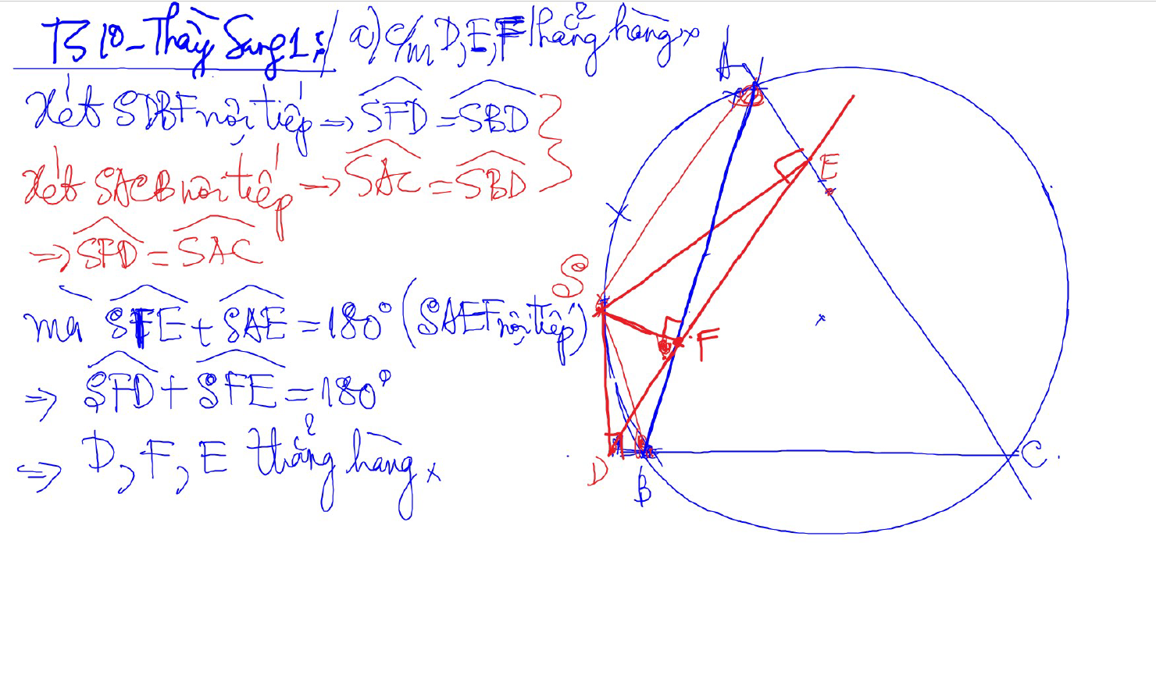
Đường thẳng SIMSON

Slide 23
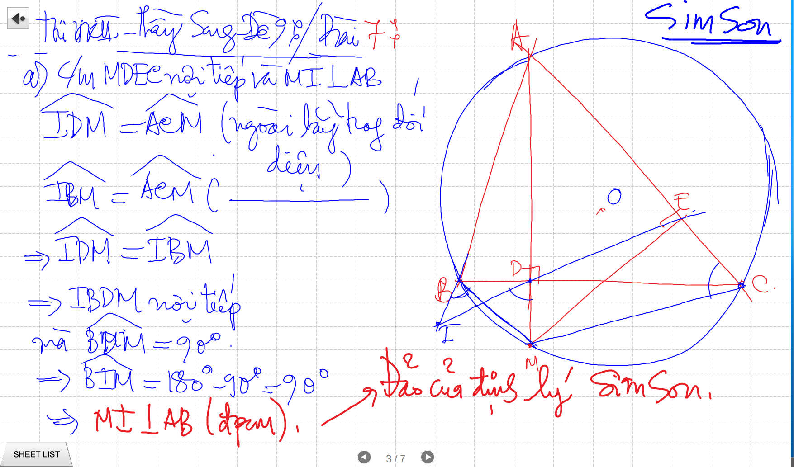
SIMSON

Slide 24
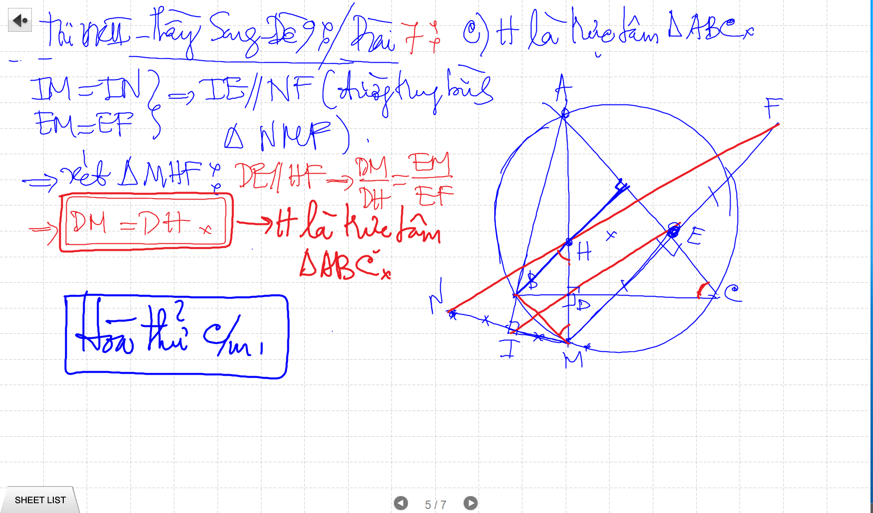
SIMSON

Slide 25
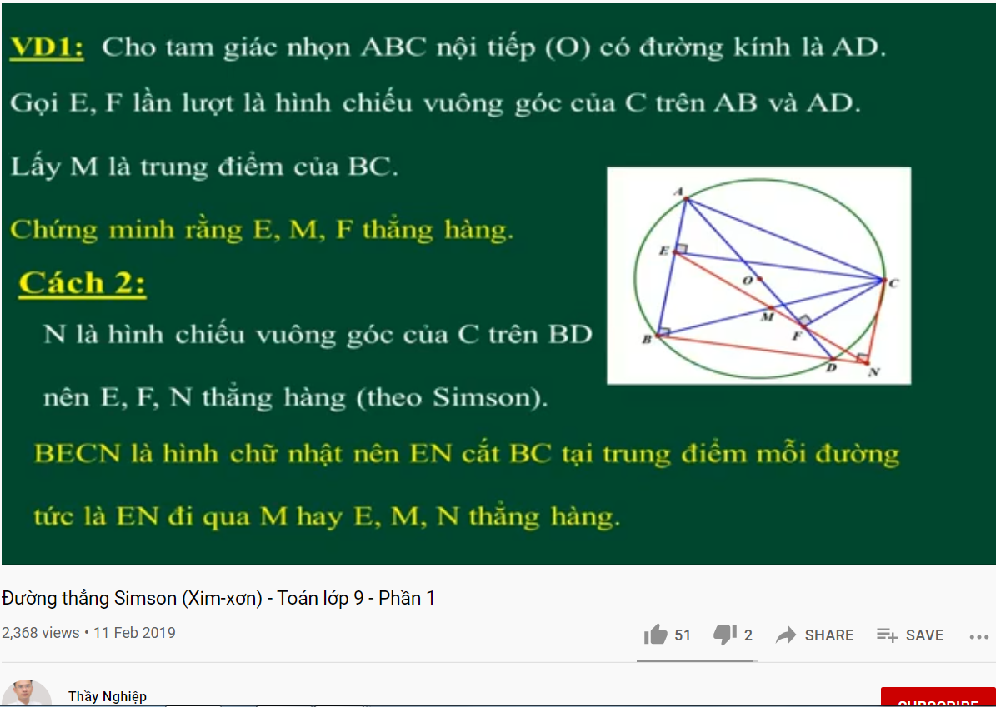
DUONG THANG SIMSON – Ap Dung

Slide 26
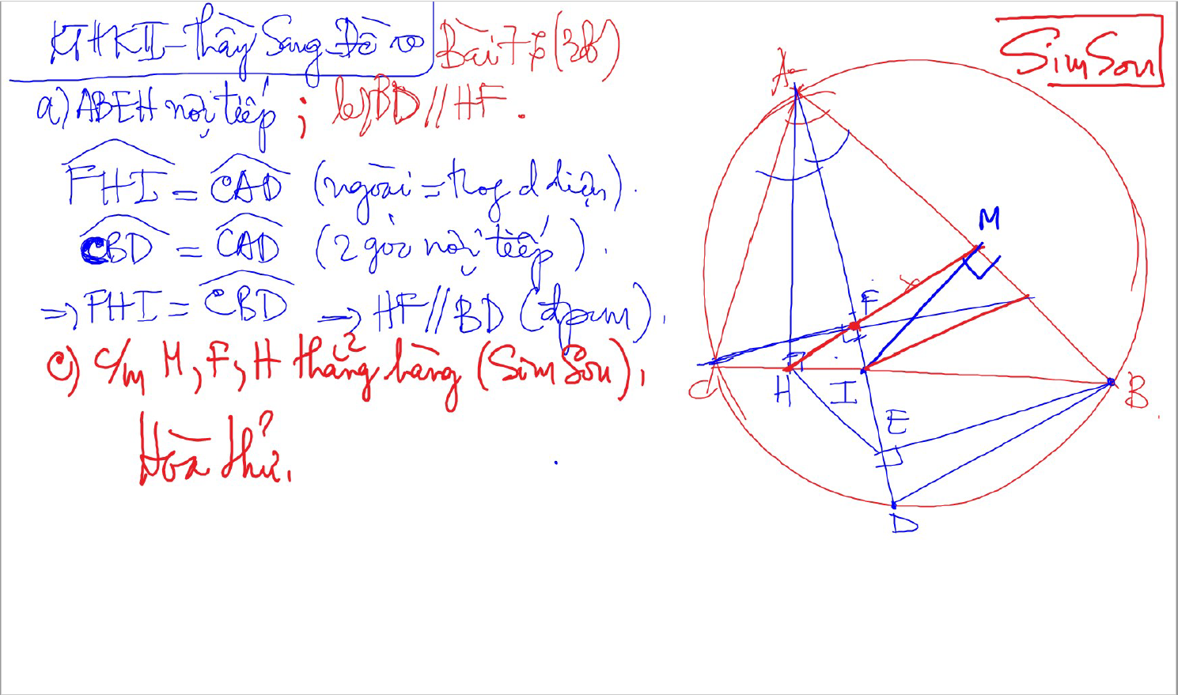
SIMSON

Slide 27
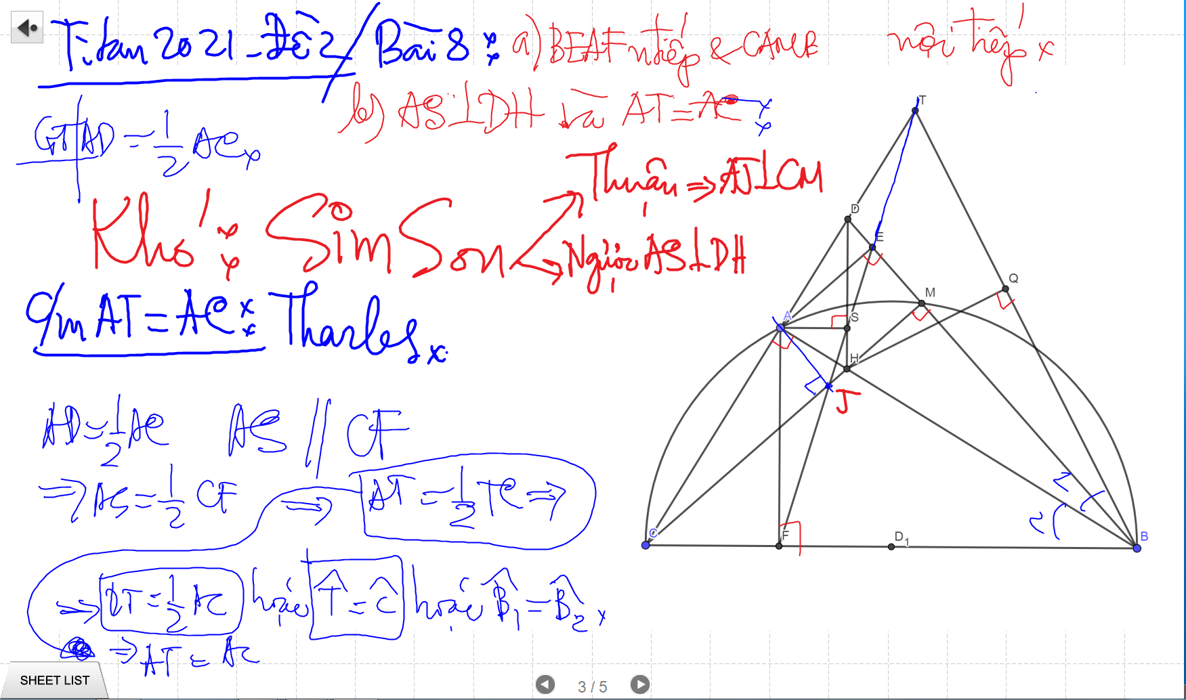
SIMSON

Slide 28
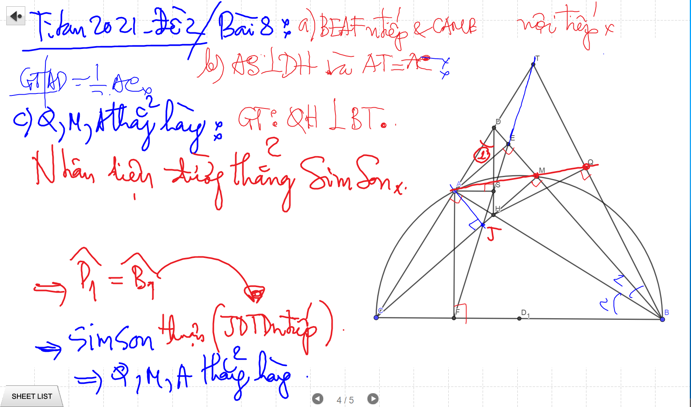
SIMSON

Slide 29
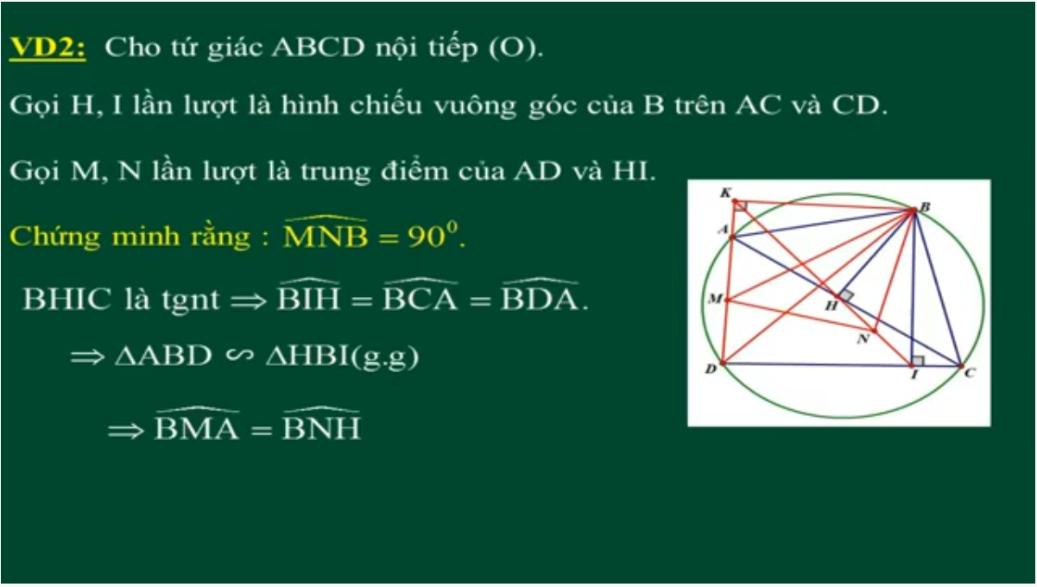
DUONG THANG SIMSON – Ap Dung

Slide 30
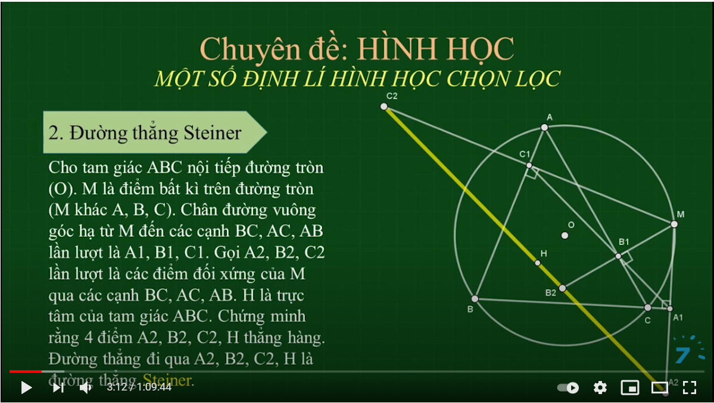
SIMSON

Slide 31
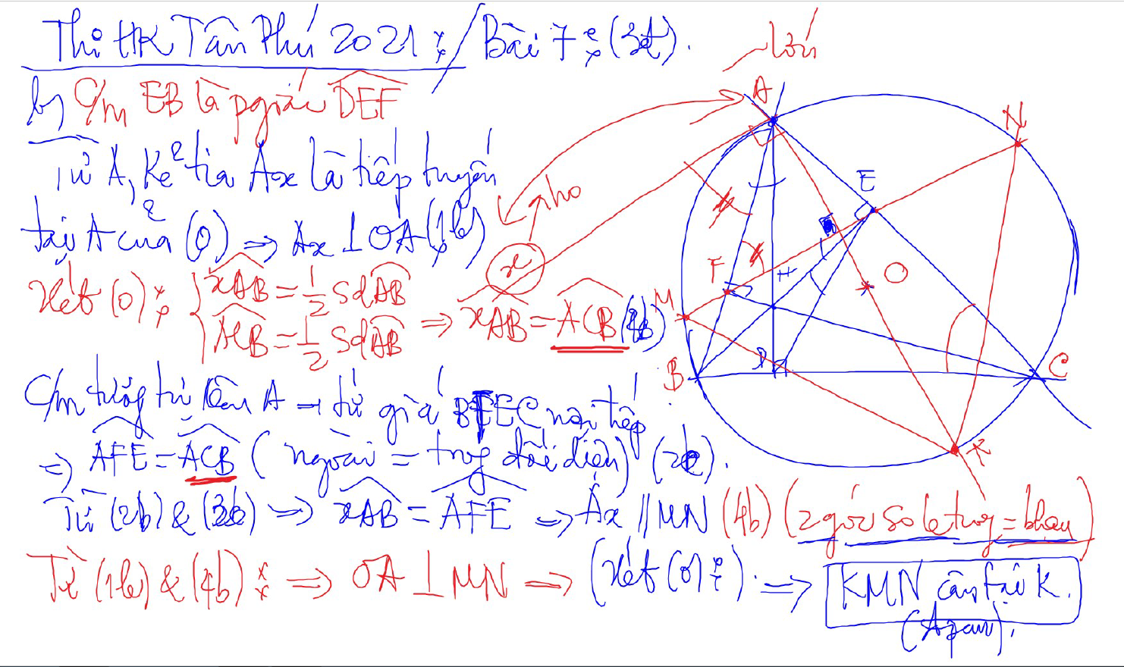
C/m tam giac dong dang truong hop 2

Slide 32
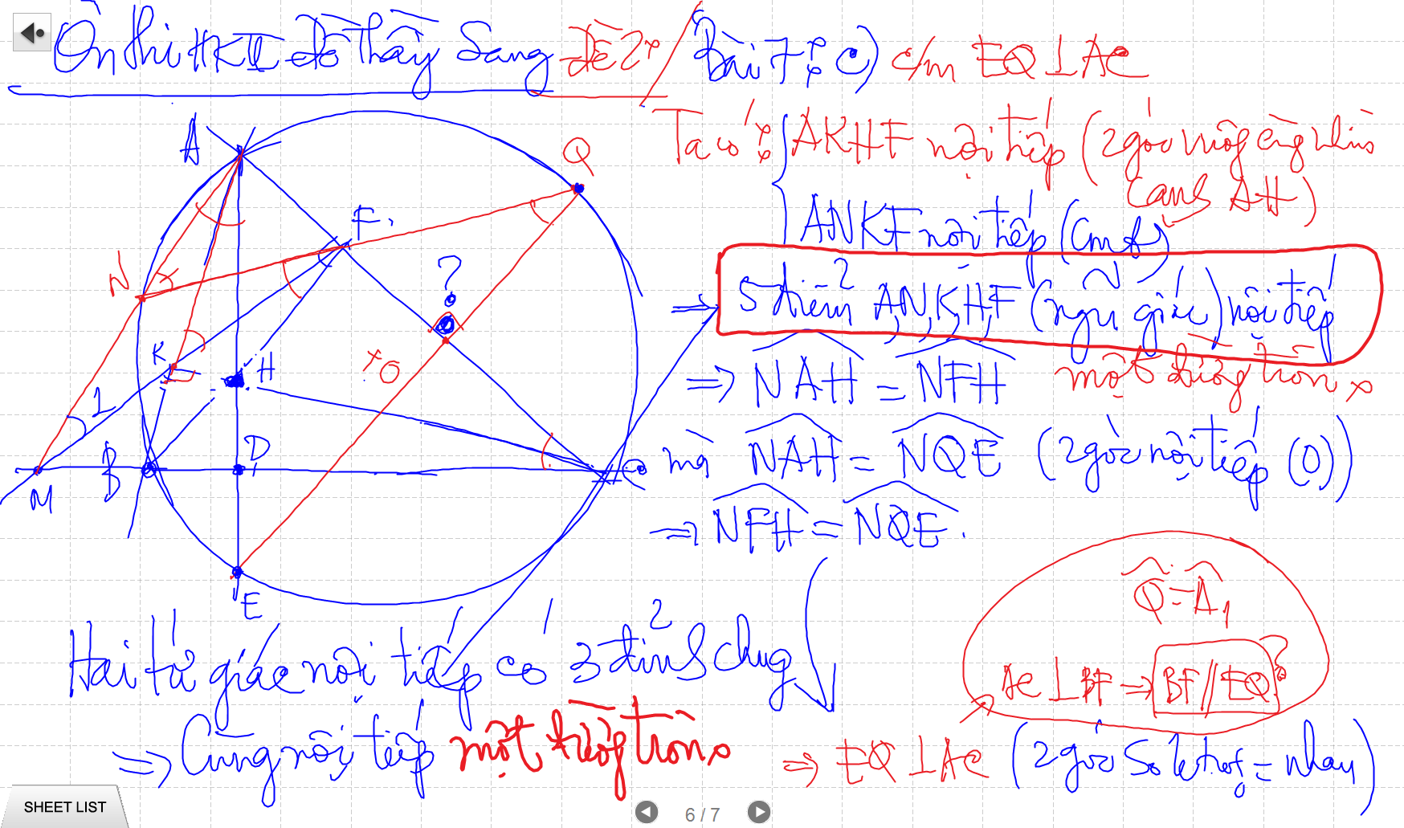

Slide 33
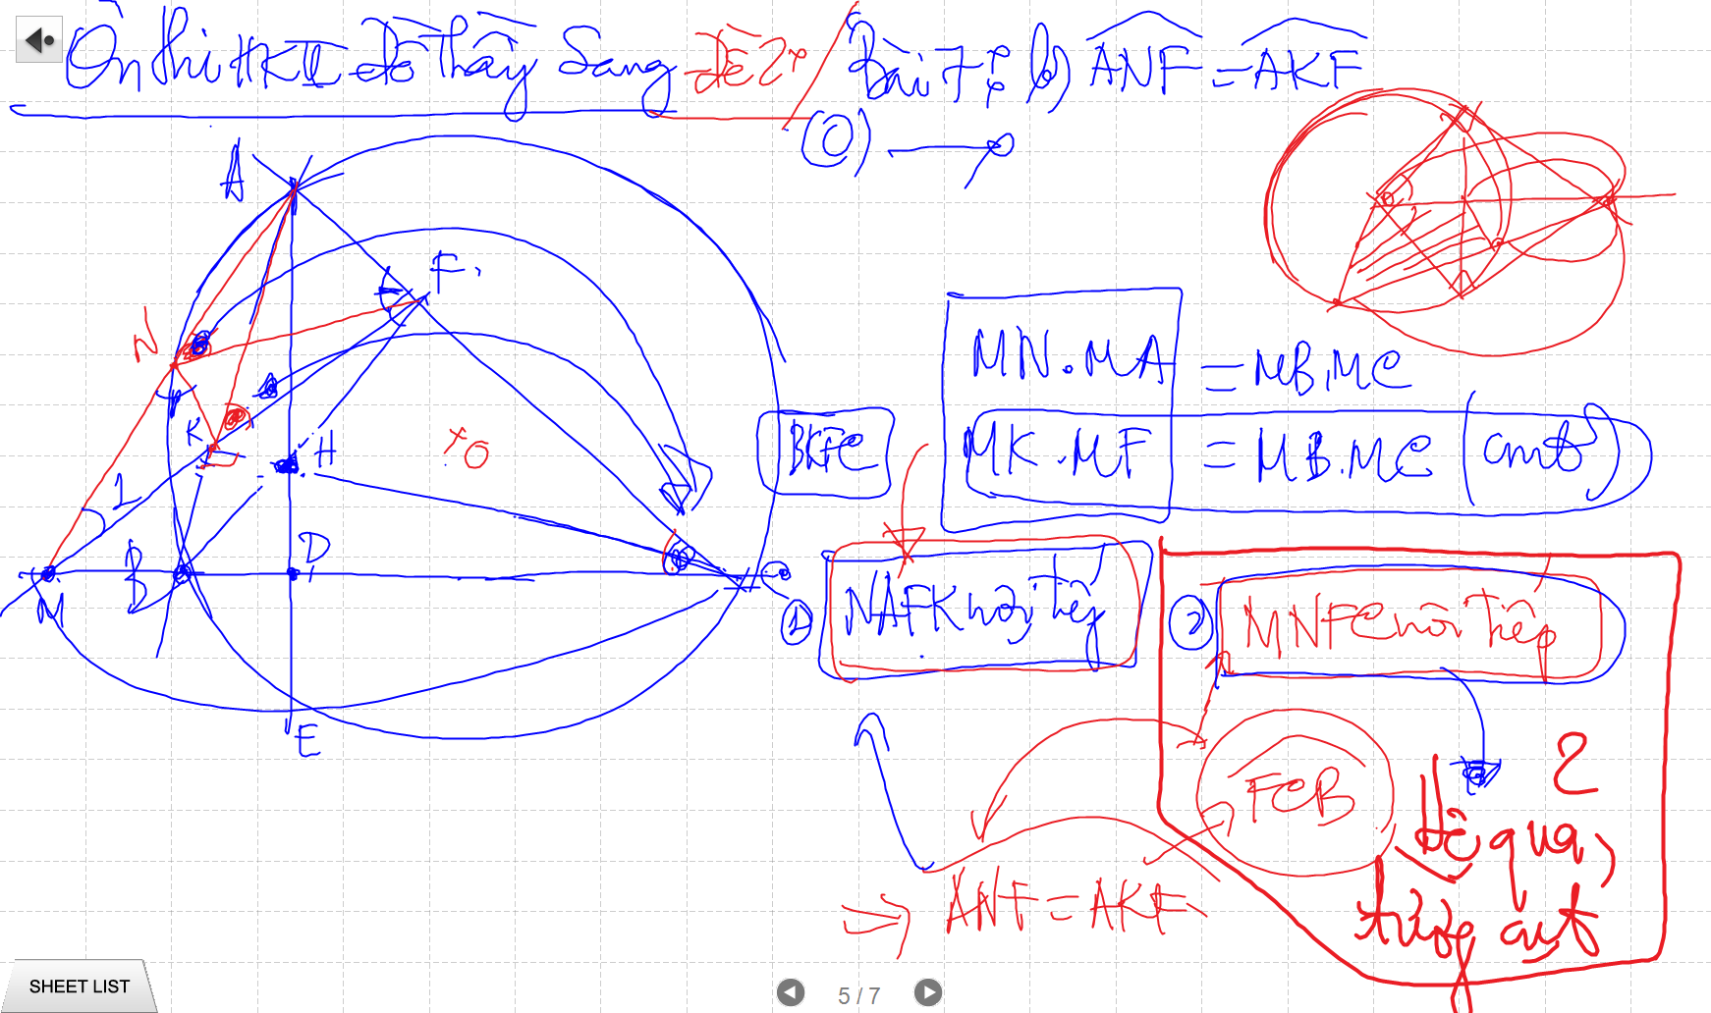
C/m tam giac dong dang truong hop 2

Slide 34
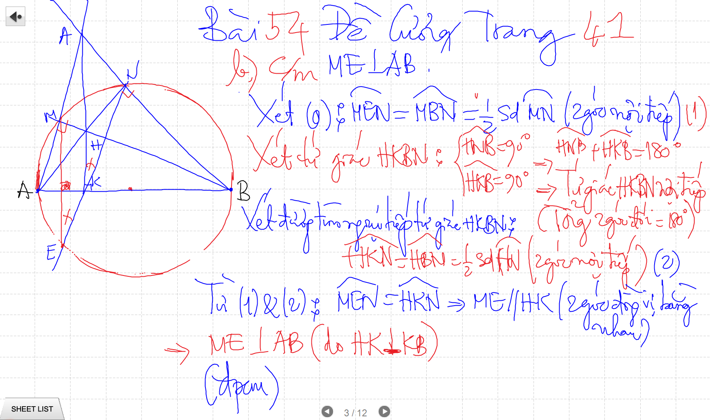

Slide 35
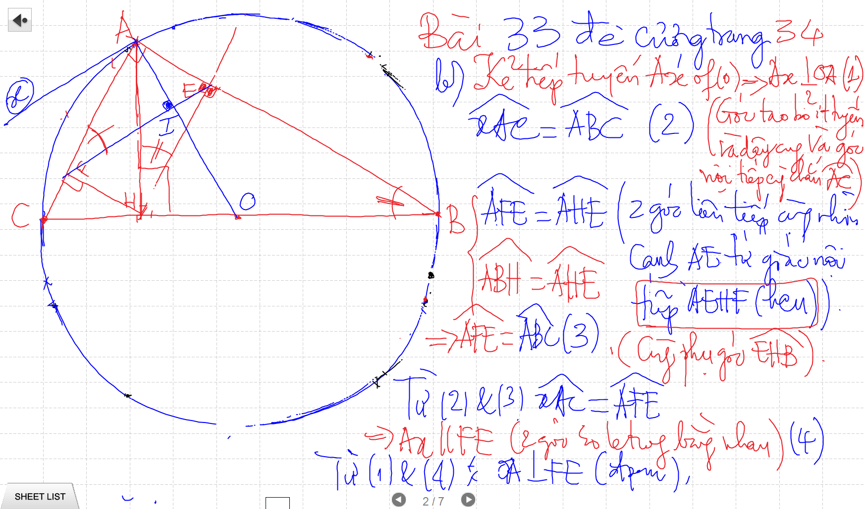
C/m tam giac dong dang truong hop 2

Slide 36
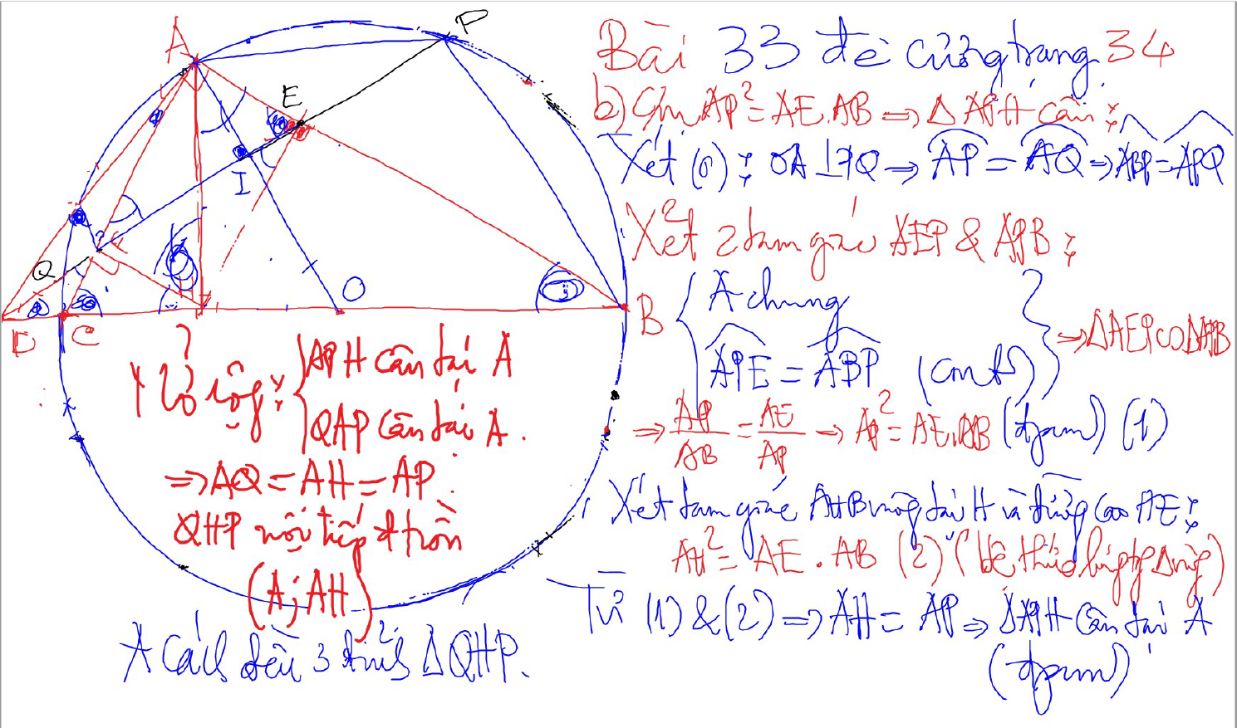
Bai 53 De Cuong – Kinh dien tam giac nhon 1 (xem trong thu muc Tu Giac Noi Tiep)

Slide 37
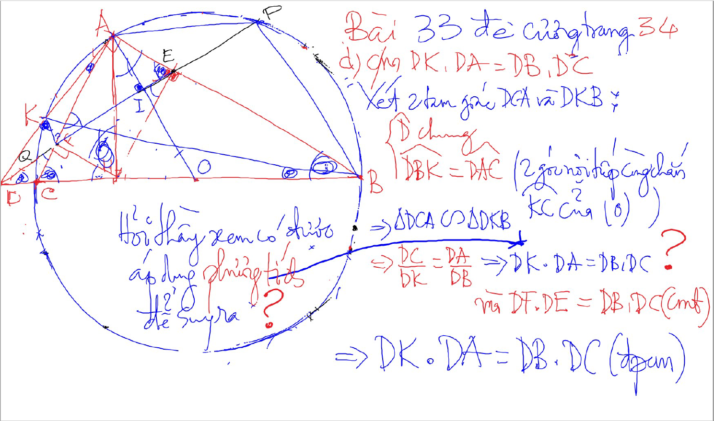
C/m tam giac dong dang truong hop 2

Slide 38
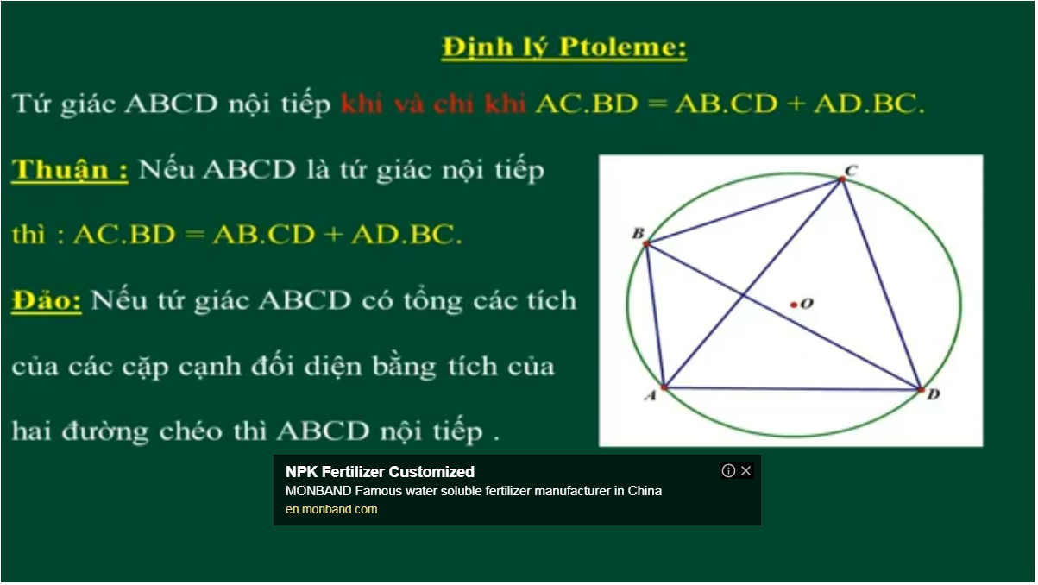
Bai 54 De Cuong – Kinh dien tam giac nhon 1 (xem trong thu muc Tu Giac Noi Tiep)

Slide 39
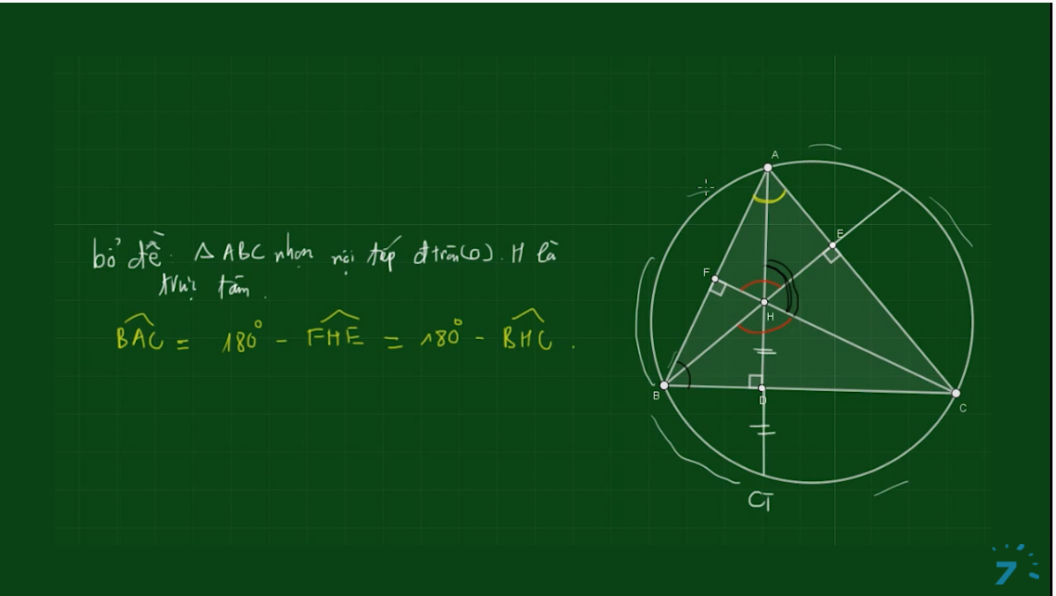
Bai 54 De Cuong – Kinh dien tam giac nhon 1 (xem trong thu muc Tu Giac Noi Tiep)

Slide 40
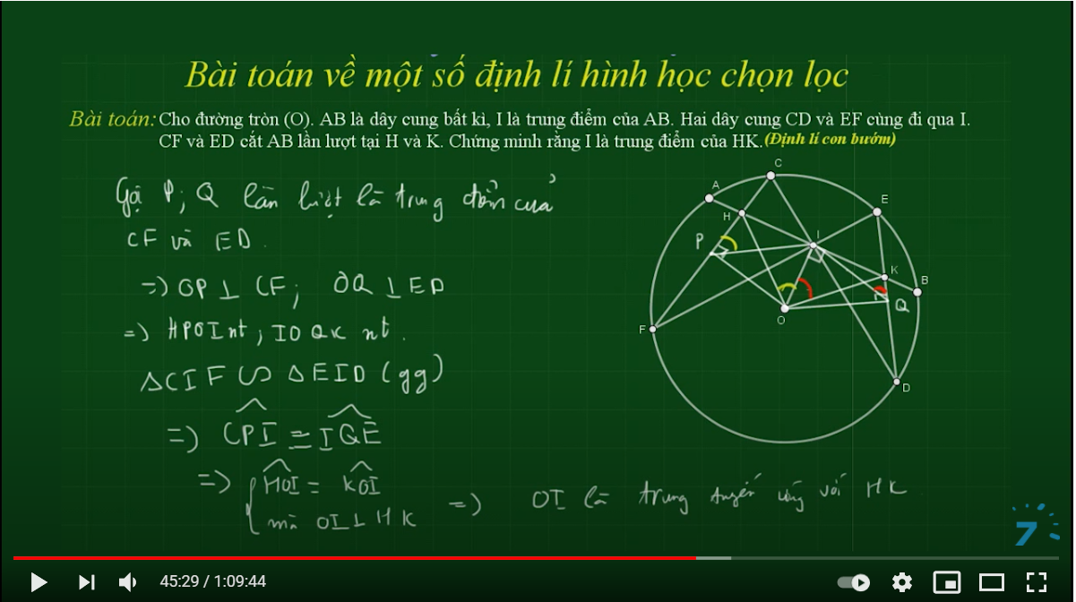

Slide 41
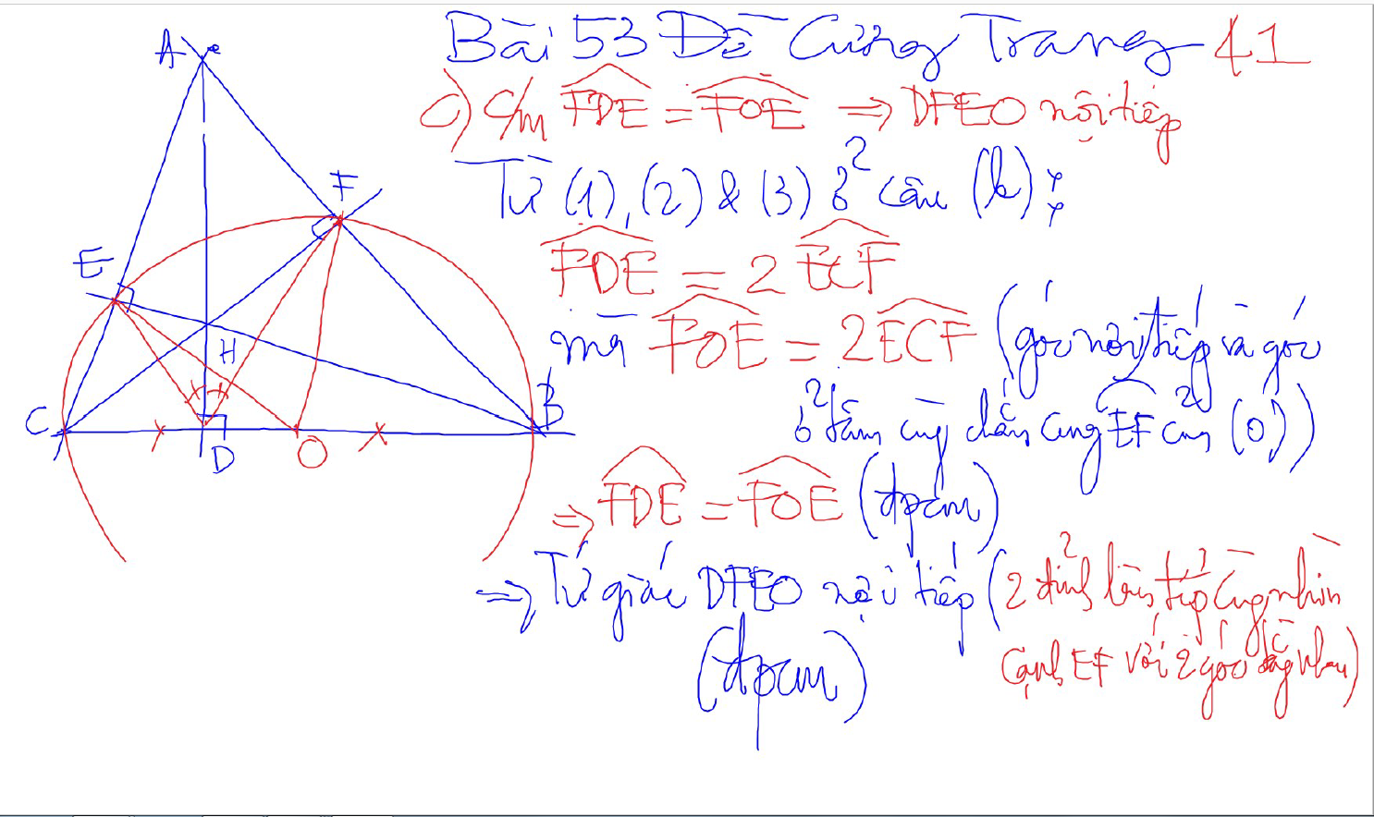
Bai 53 De Cuong – Kinh dien tam giac nhon 1 (xem trong thu muc Tu Giac Noi Tiep)

Slide 42
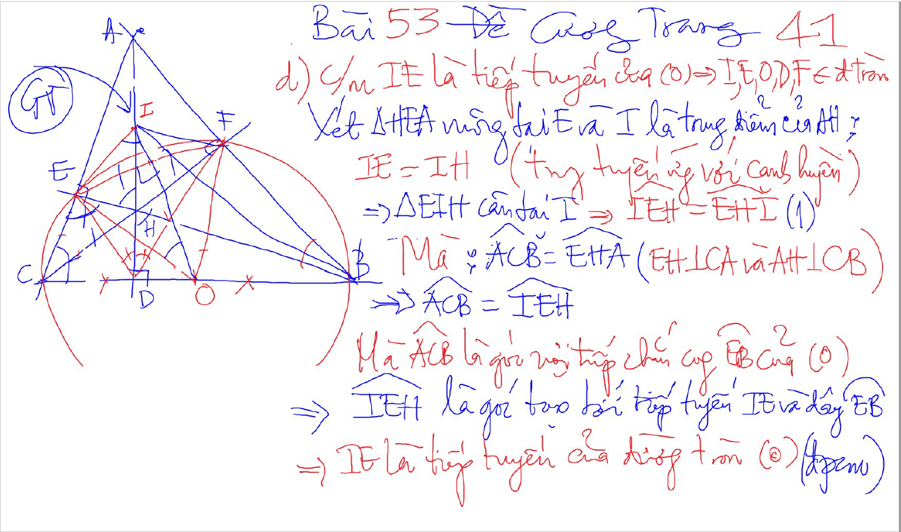
Bai 53 De Cuong – Kinh dien tam giac nhon 1 (xem trong thu muc Tu Giac Noi Tiep)

Slide 43
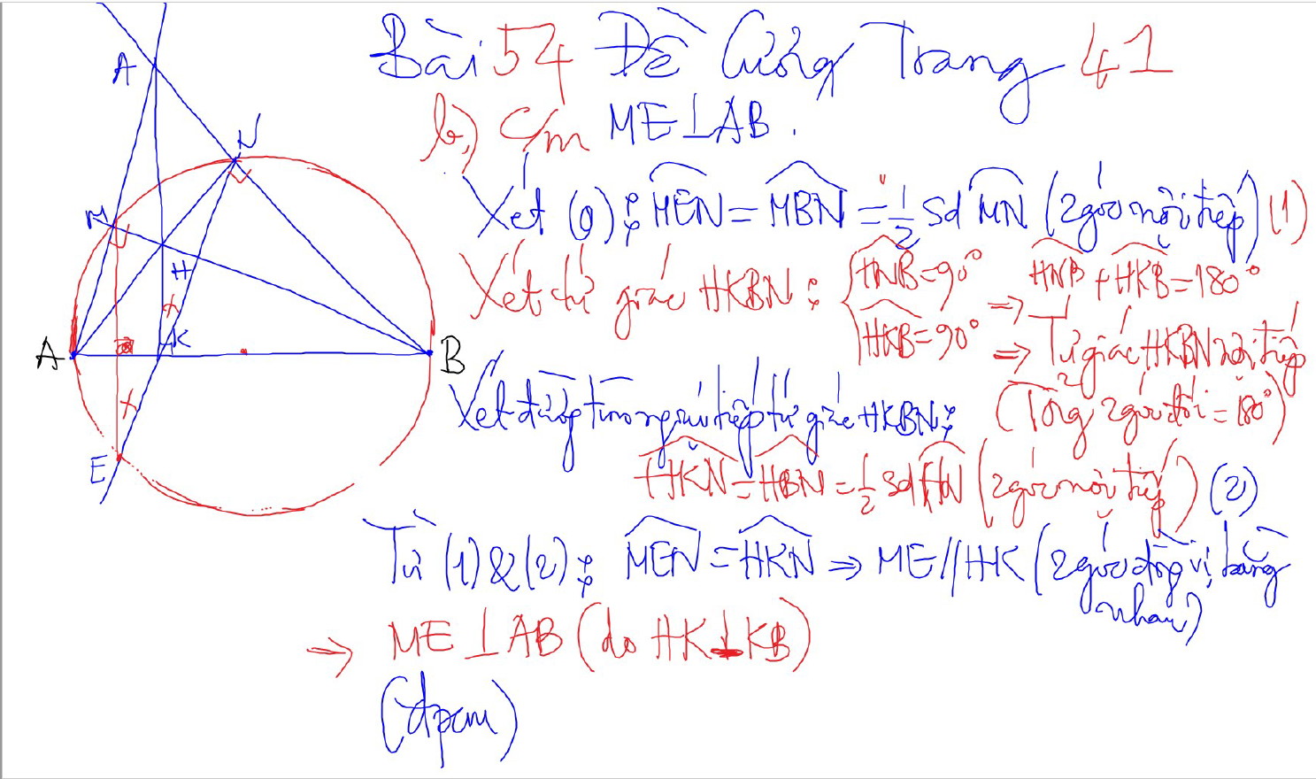
Bai 54 De Cuong – Kinh dien tam giac nhon 1 (xem trong thu muc Tu Giac Noi Tiep)

Slide 44
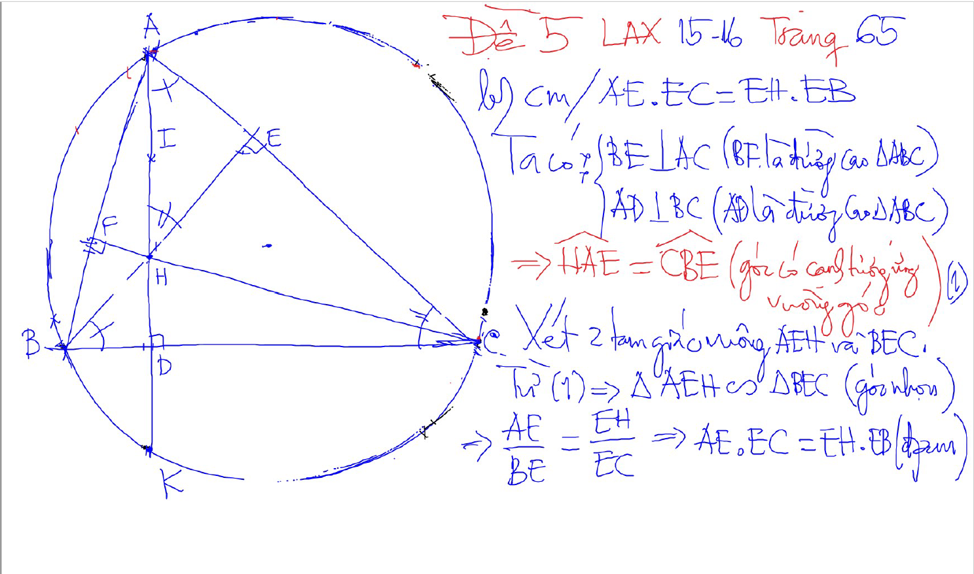
2 tam giac dong dang (truong hop 1)
2 goc bang nhau
1 goc nhon bang nhau

Slide 45
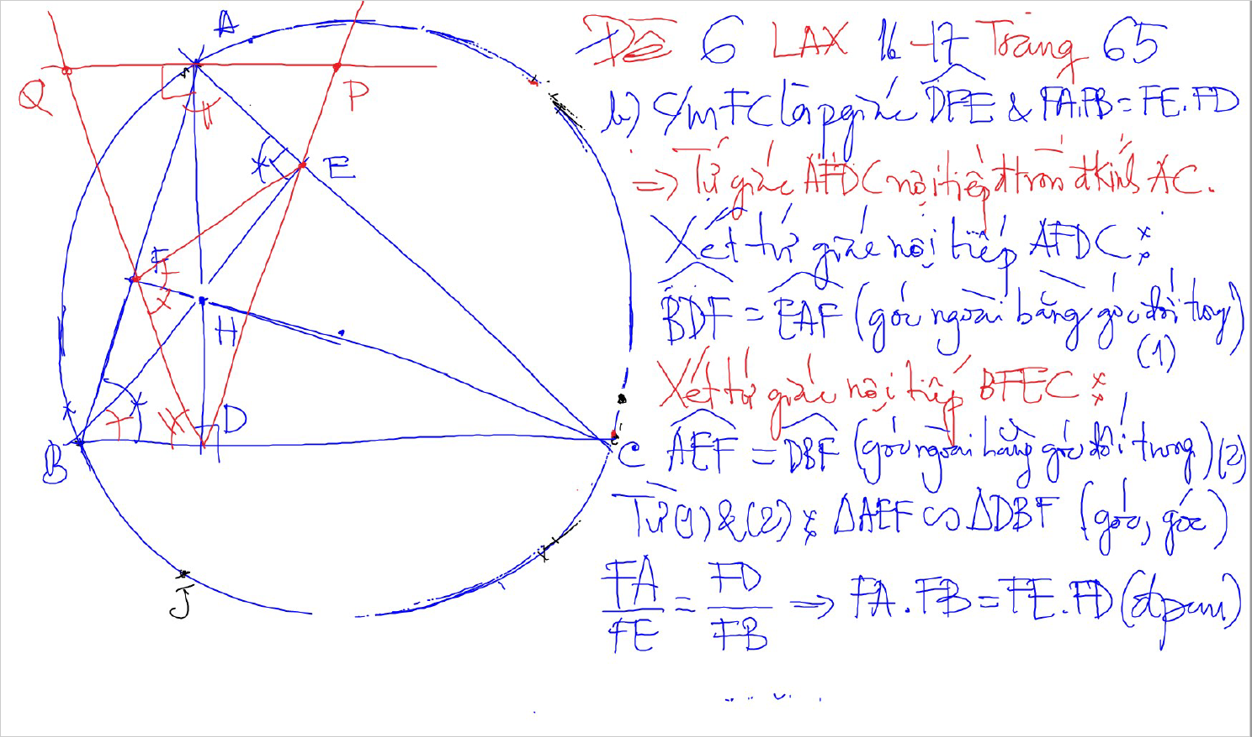
2 tam giac dong dang (truong hop 1)
2 goc bang nhau
1 goc nhon bang nhau

Slide 46
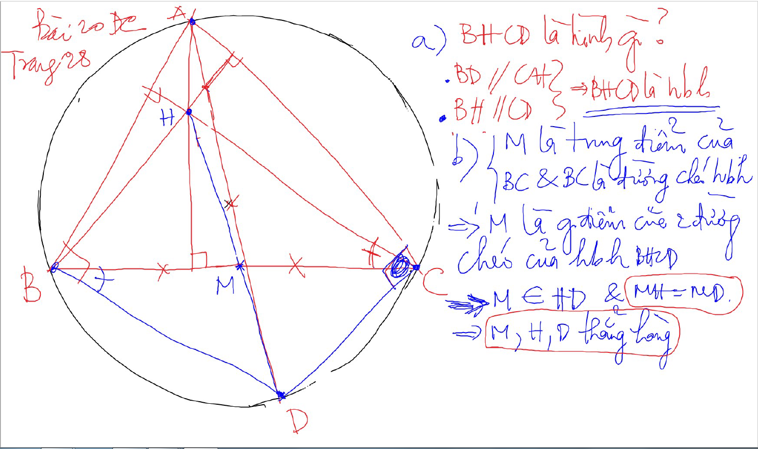

Slide 47
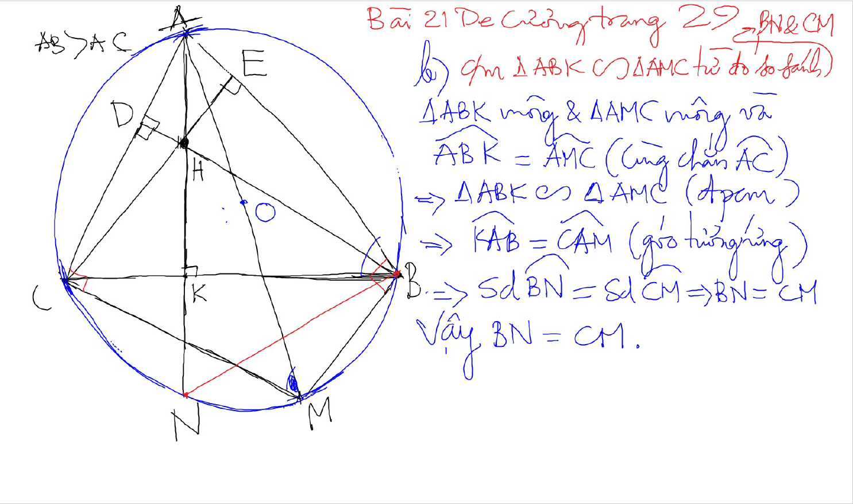

Slide 48
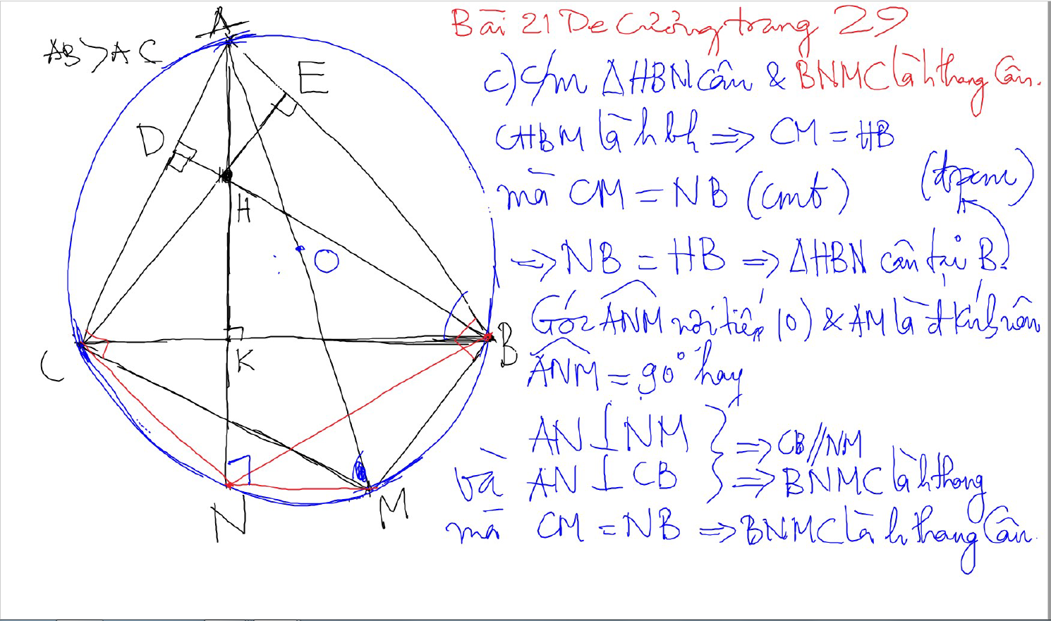

Slide 49
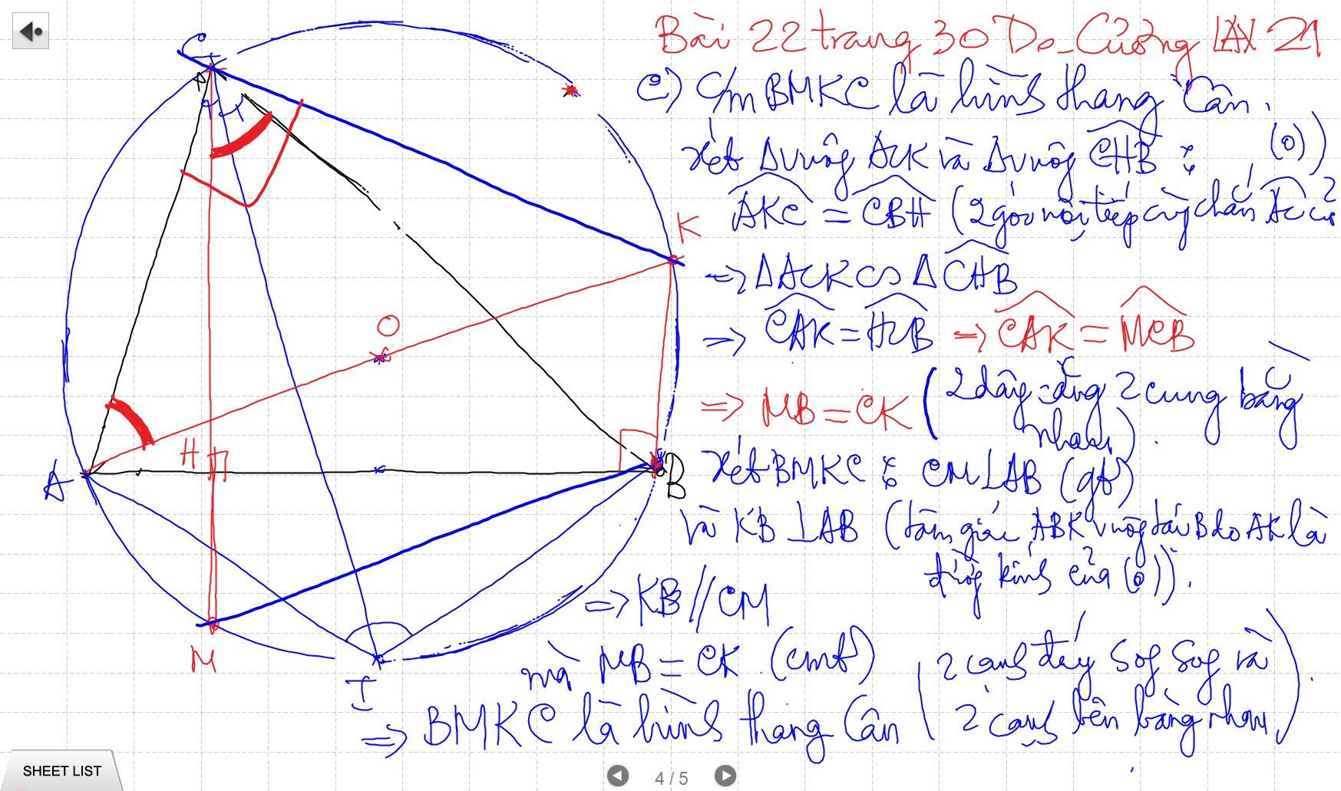

Slide 50
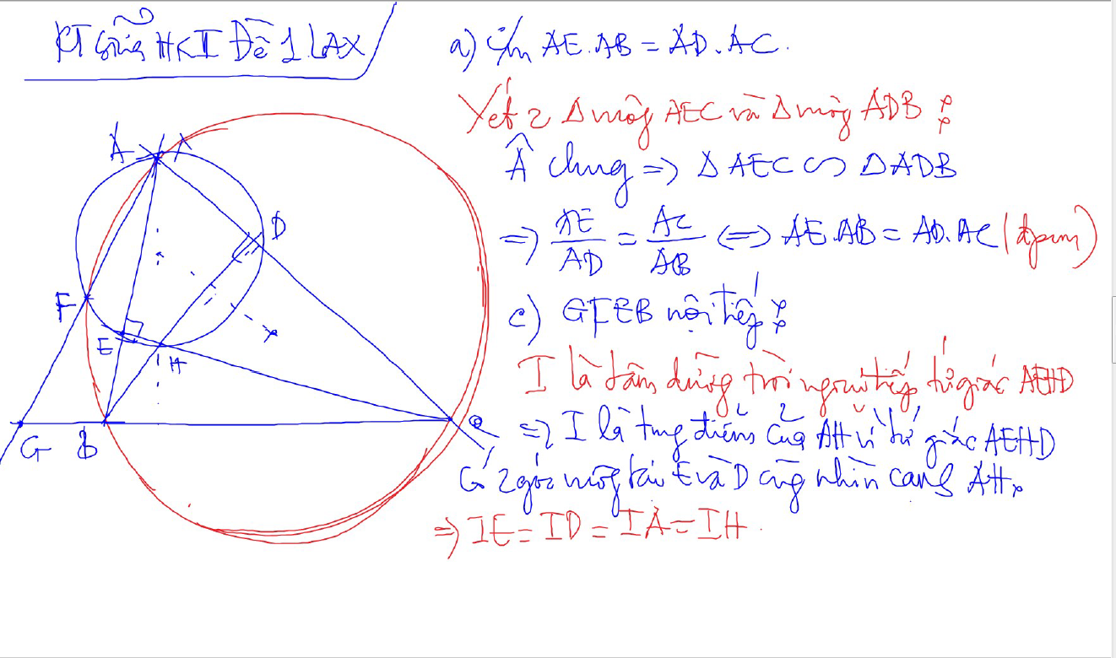

Slide 51


Slide 52


Slide 53


Slide 54


Quan he giua canh day va khoang cach den truc tam
AH²+BC²$=4R$²
CH²+AB²=4R²
BH²+AC²=4R²

Slide 55


Truc Tam: 6 tu giac noi tiep

Slide 56

Truc tam: Tinh chat chan 3 duong cao
Chan 3 duong cao tao thanh tam giac DEF
3 duong cao cua tam giac ABC cung la 3 duong phan giac cua tam giac chan duong cao (DEF)
3 tam giac nho o 3 dinh (3 cai banh u) dong dang voi tam giac lon

Slide 57


3 duong trung truc dong qui, la tam cua duong tron ngoai tiep tam giac
Giao diem cua 3 duong phan giac la tam duong trong noi tiep tam giac

Slide 58


Slide 59

Cach ve duong phan giac cua goc noi tiep

Slide 60

Cach ve duong phan giac cua goc noi tiep

Slide 61

Cach ve duong phan giac cua goc noi tiep

Slide 62

Cach ve duong phan giac cua goc noi tiep

Slide 63

Cach ve duong phan giac cua goc noi tiep

Slide 64

C/m tam giac dong dang truong hop 2

